Slide 1
Distance Distribution with Simulated BSD

Slide 2
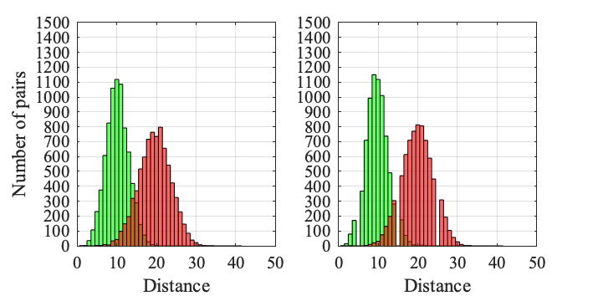
Route length = 10, Accuracy = 75%
Union Square (12%)
Wall Street (19%)

Slide 3
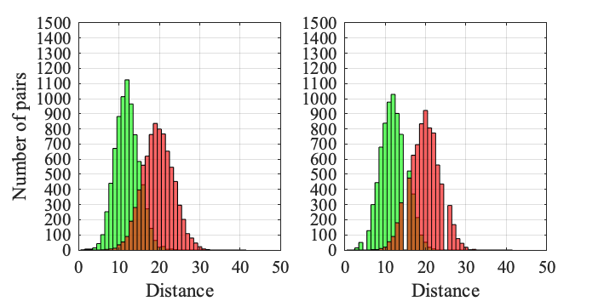
Route length = 10, Accuracy = 70%
Union Square (3.6%)
Wall Street (5.4%)

Slide 4
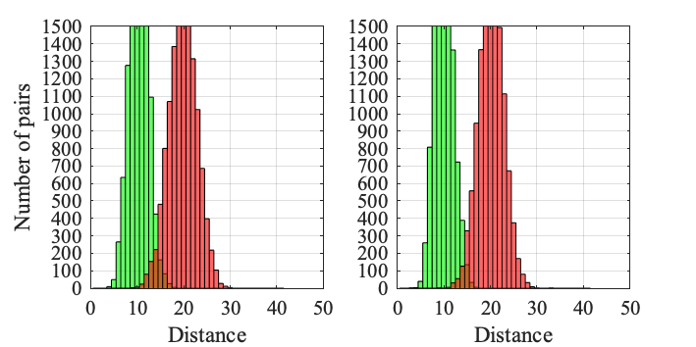
Route length = 20, Accuracy = 75%
Union Square (41.4%)
Wall Street (66%)

Slide 5
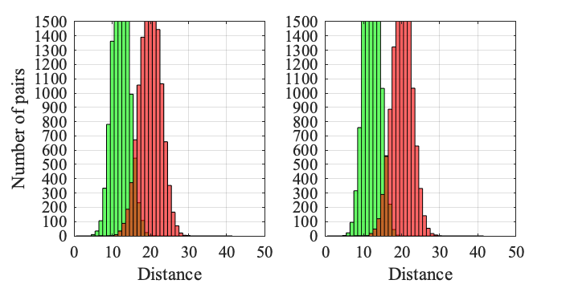
Route length = 20, Accuracy = 70%
Union Square (19.4%)
Wall Street (26.4%)

Slide 6
Distance Distribution with Real BSD

Slide 7
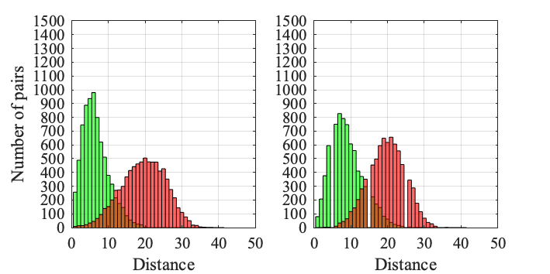
Route length = 10
Union Square (7.8%)
Wall Street (8.4%)

Slide 8
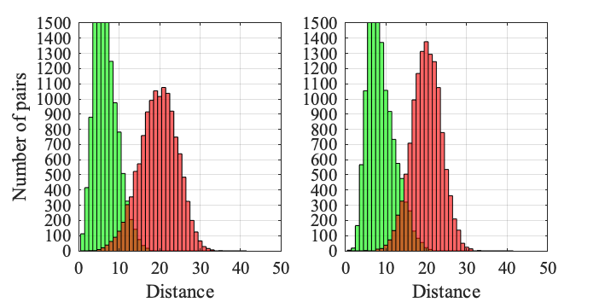
Route length = 20
Union Square (26.2%)
Wall Street (37.4%)

Slide 9
Dataset Statisctic for Training, Validation and Testing

Slide 10
Training Set
Num of junctions | Num of non_junctions | Num of gaps | Num of non_gaps
63404 | 124130 | 88272 | 99262
187534 |  | 187534
375068
Validation Set (Hudson River)
Num of junctions | Num of non_junctions | Num of gaps | Num of non_gaps
2989 | 7011 | 3372 | 6628
10000 |  | 10000
20000

Slide 11
Testing Set (Wall Street)
Num of junctions | Num of non_junctions | Num of gaps | Num of non_gaps
4260 | 5740 | 4023 | 5977
10000 |  | 10000
20000
Testing Set (Union Square)
Num of junctions | Num of non_junctions | Num of gaps | Num of non_gaps
3156 | 6844 | 4297 | 5703
10000 |  | 10000
20000

Slide 12
Testing Set (CMU)
Num of junctions | Num of non_junctions | Num of gaps | Num of non_gaps
3562 | 6438 | 5641 | 4359
10000 |  | 10000
20000

Slide 13
Hudson River

Slide 14
Junction | Accuracy | precision | recall | specificity | F1 | loss
Resnet18_accuracy | 83.8% | 79.4% | 61.7% | 93.2% | 69.4 | 0.3911
Resnet18_precision | 83.7% | 82.2% | 58.2% | 94.6% | 68.1 | 0.3897
Resnet18_recall | 78.2% | 60.8% | 75.9% | 79.1% | 67.5 | 1.0985
Resnet18_F1 | 82.7% | 72.8% | 67.4% | 89.3% | 70 | 0.4226
Resnet18_loss | 83.7% | 82.2% | 58.2% | 94.6% | 68.1 | 0.3897

Slide 15
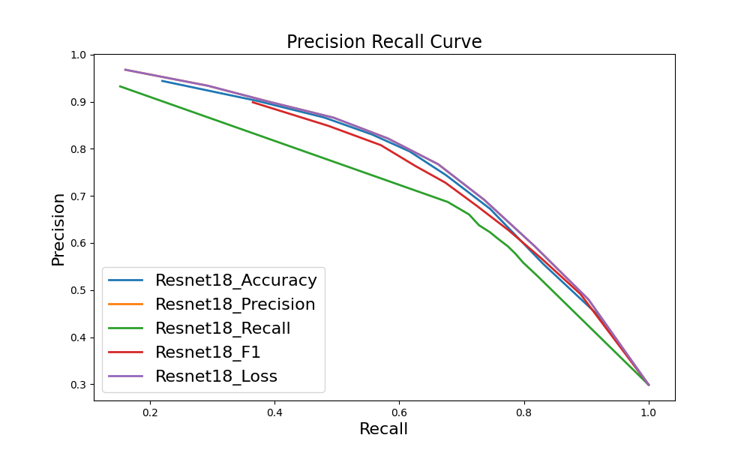

Slide 16
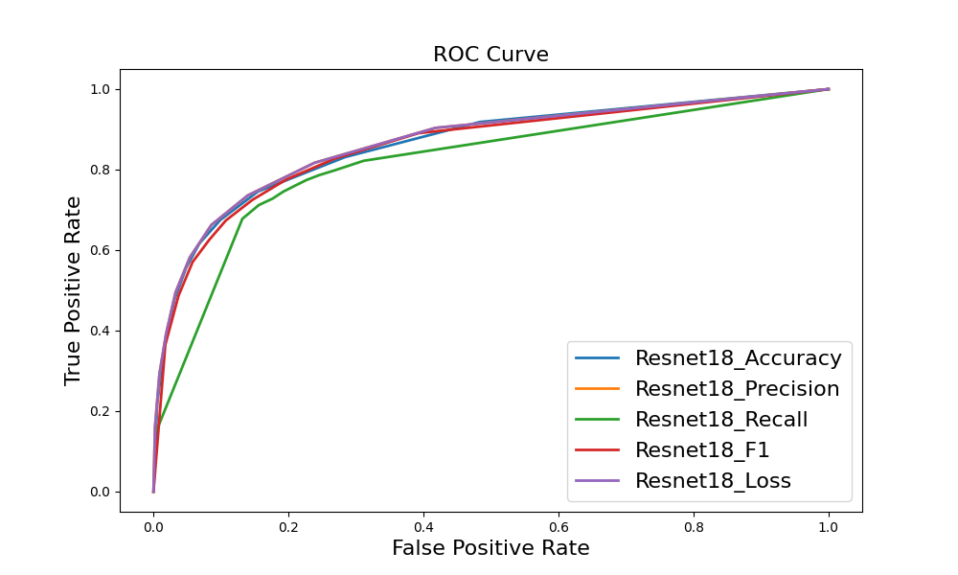

Slide 17
Junction ghmc | Accuracy | precision | recall | specificity | F1 | loss
Resnet18_accuracy | 82.1% | 74.8% | 60.5% | 91.3% | 66.9 | 0.8138
Resnet18_precision | 80.9% | 84.3% | 44.3% | 96.5% | 58.1 | 0.6627
Resnet18_recall | 72.8% | 53.1% | 79.3% | 70.1% | 63.6 | 0.5092
Resnet18_F1 | 79.4% | 64.2% | 70.8% | 83.1% | 67.3 | 1.2639
Resnet18_loss | 74.3% | 56.3% | 62.1% | 79.5% | 59.1 | 0.4993

Slide 18
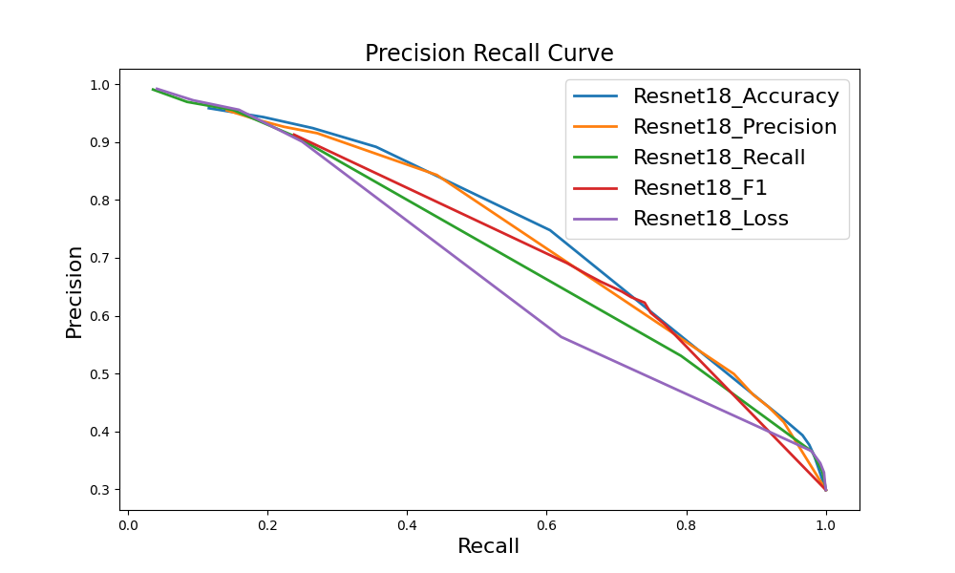

Slide 19
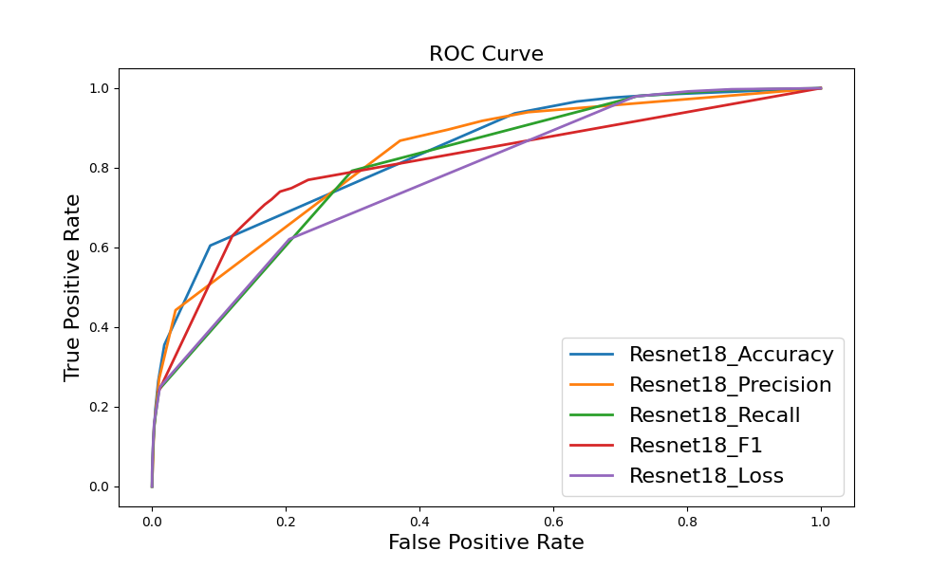

Slide 20
Gap | Accuracy | precision | recall | specificity | F1 | loss
Resnet18_accuracy | 84.2% | 78.1% | 73.9% | 89.5% | 76 | 0.4246
Resnet18_precision | 83.6% | 80.7% | 67.3% | 91.8% | 73.4 | 0.4074
Resnet18_recall | 84.2% | 74.5% | 80.9% | 85.9% | 77.6 | 0.4023
Resnet18_F1 | 84.2% | 74.5% | 80.9% | 85.9% | 77.6 | 0.4023
Resnet18_loss | 84.2% | 74.5% | 80.9% | 85.9% | 77.6 | 0.4023

Slide 21
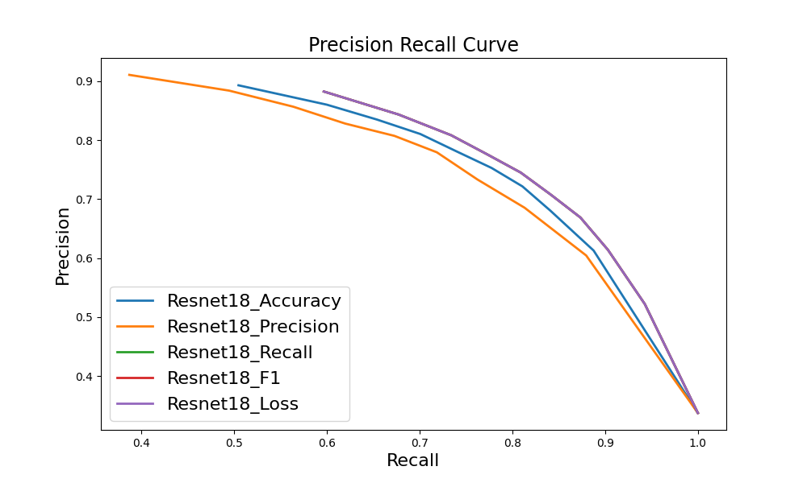

Slide 22
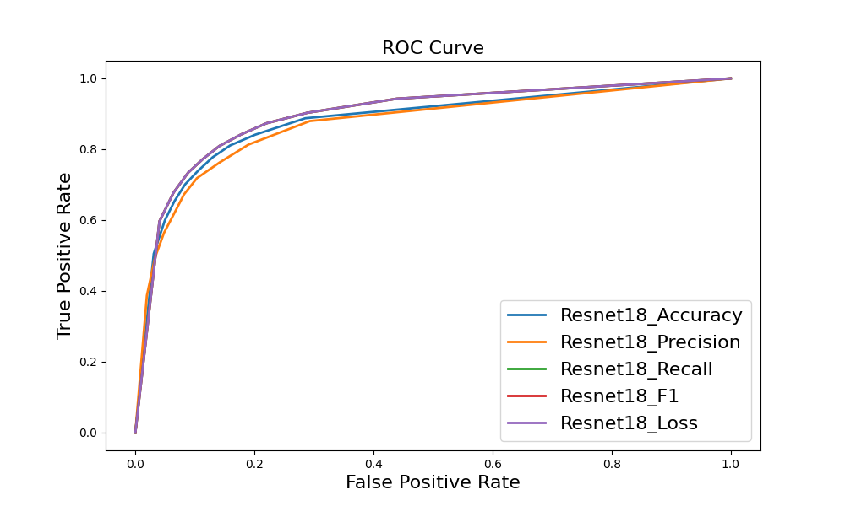

Slide 23
Gap ghmc | Accuracy | precision | recall | specificity | F1 | loss
Resnet18_accuracy | 73.7% | 79.1% | 69% | 90.8% | 73.7 | 1.0063
Resnet18_precision | 71.5% | 79.2% | 65.2% | 91.3% | 71.5 | 0.8318
Resnet18_recall | 73.5% | 67.3% | 81% | 79.9% | 73.5 | 0.9043
Resnet18_F1 | 74.7% | 69.8% | 80.3% | 82.3% | 74.7 | 0.9152
Resnet18_loss | 79.4% | 77.1% | 55.2% | 91.7% | 64.4 | 0.5495

Slide 24
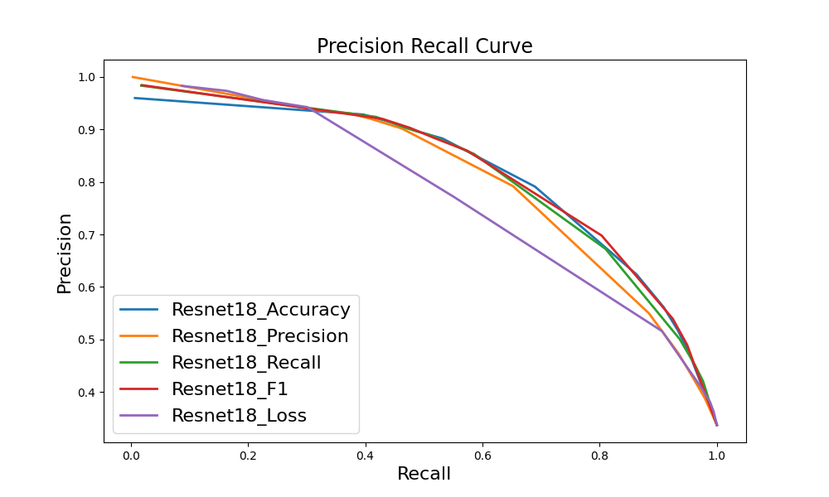

Slide 25
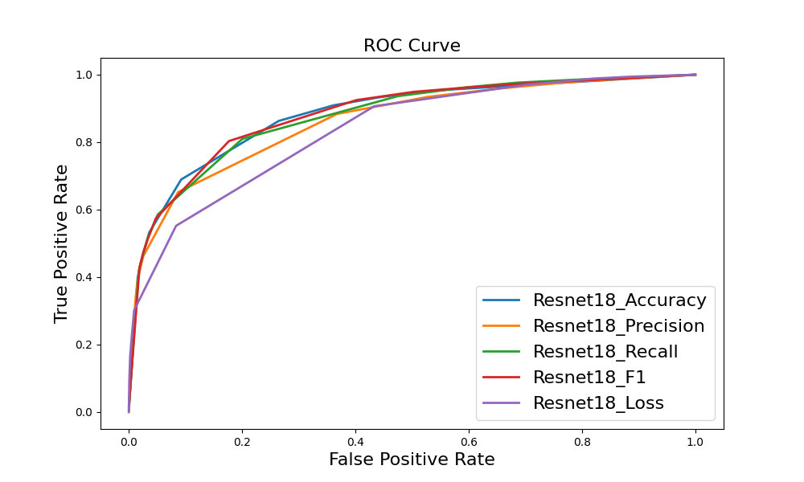

Slide 26
Wall Street

Slide 27
Junction | Accuracy | precision | recall | specificity | F1 | loss
Resnet18_accuracy | 73.2% | 82.8% | 46.9% | 92.8% | 59.9 | 0.5575
Resnet18_precision | 72.3% | 86.8% | 41.2% | 95.3% | 55.9 | 0.5903
Resnet18_recall | 71.6% | 67.3% | 65.1% | 76.5% | 66.2 | 1.3463
Resnet18_F1 | 73.1% | 77.7% | 51.5% | 89% | 62 | 0.5974
Resnet18_loss | 72.3% | 86.8% | 41.2% | 95.3% | 55.9 | 0.5903

Slide 28
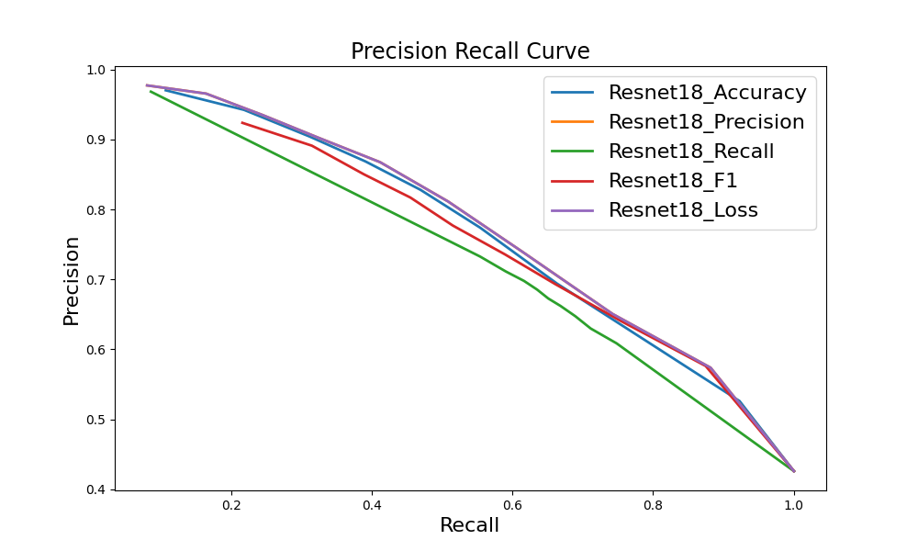

Slide 29
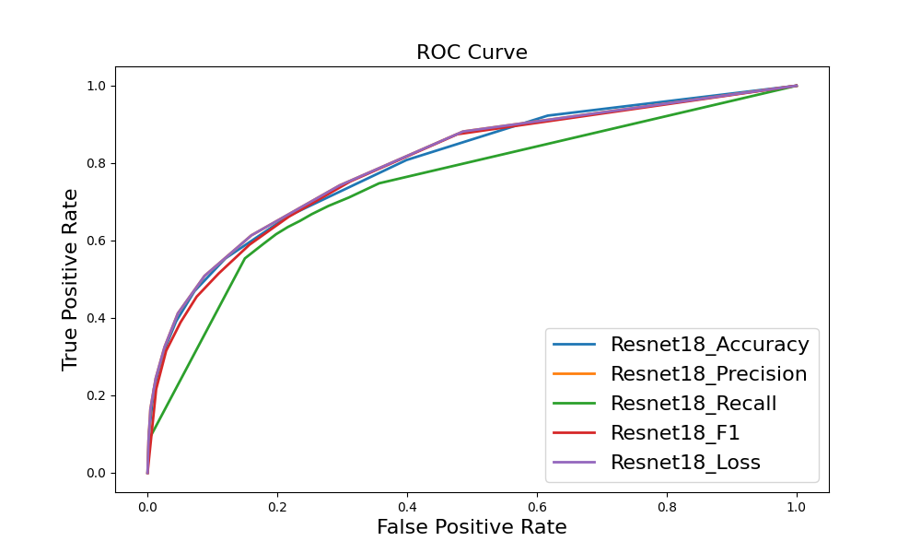

Slide 30
Junction ghmc | Accuracy | precision | recall | specificity | F1 | loss
Resnet18_accuracy | 72.4% | 78.7% | 48.3% | 90.3% | 59.9 | 0.8267
Resnet18_precision | 69.1% | 87.2% | 32.2% | 96.5% | 47 | 0.6982
Resnet18_recall | 68.8% | 62.1% | 68.7% | 68.9% | 65.2 | 0.5053
Resnet18_F1 | 71.5% | 69.1% | 59.7% | 80.2% | 64.1 | 1.1880
Resnet18_loss | 69.4% | 69.2% | 50.7% | 83.2% | 58.5 | 0.5351

Slide 31
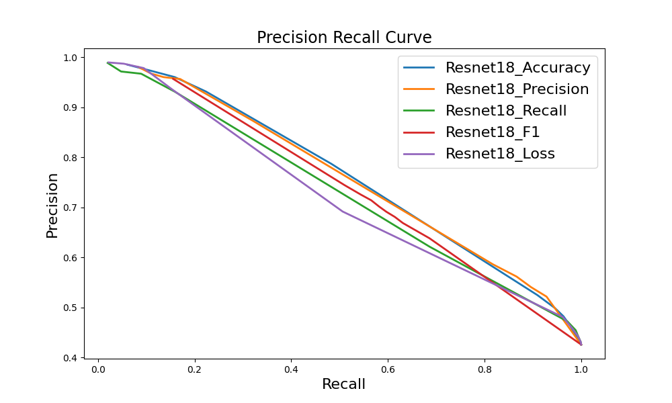

Slide 32
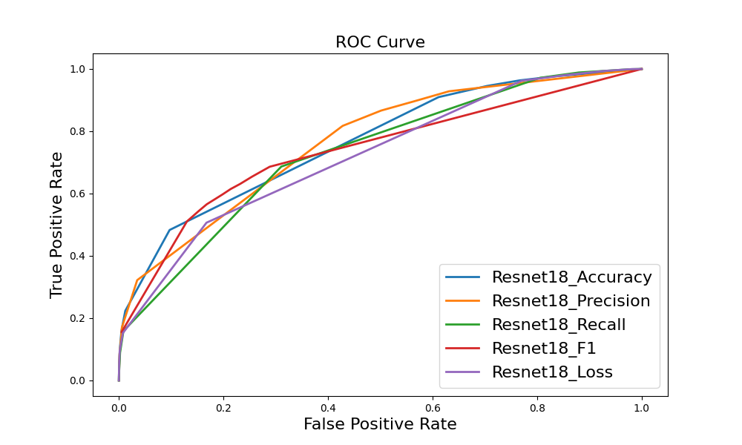

Slide 33
Gap | Accuracy | precision | recall | specificity | F1 | loss
Resnet18_accuracy | 79% | 74.3% | 73.2% | 83% | 73.7 | 0.4974
Resnet18_precision | 77.1% | 76% | 62.8% | 86.7% | 68.8 | 0.502
Resnet18_recall | 81.3% | 75.1% | 80.1% | 82.2% | 77.5 | 0.4655
Resnet18_F1 | 81.3% | 75.1% | 80.1% | 82.2% | 77.5 | 0.4655
Resnet18_loss | 81.3% | 75.1% | 80.1% | 82.2% | 77.5 | 0.4655

Slide 34
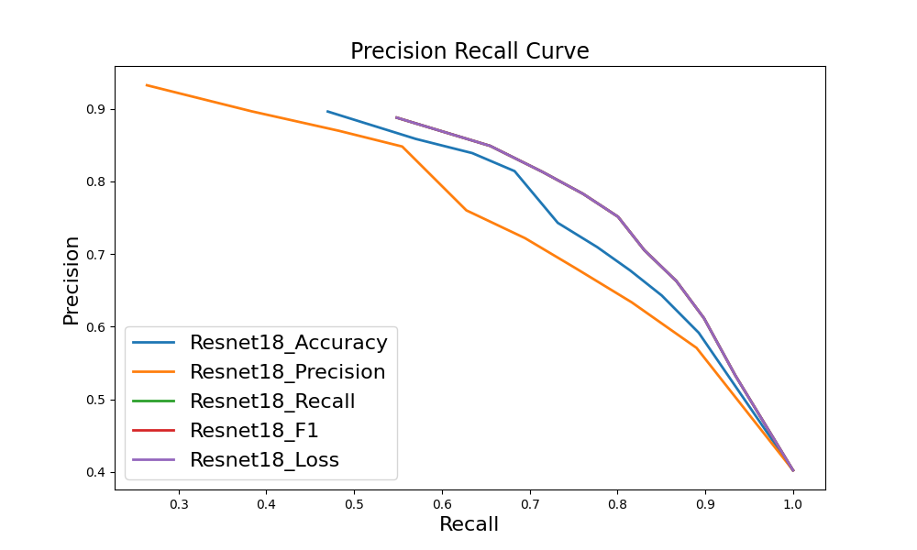

Slide 35
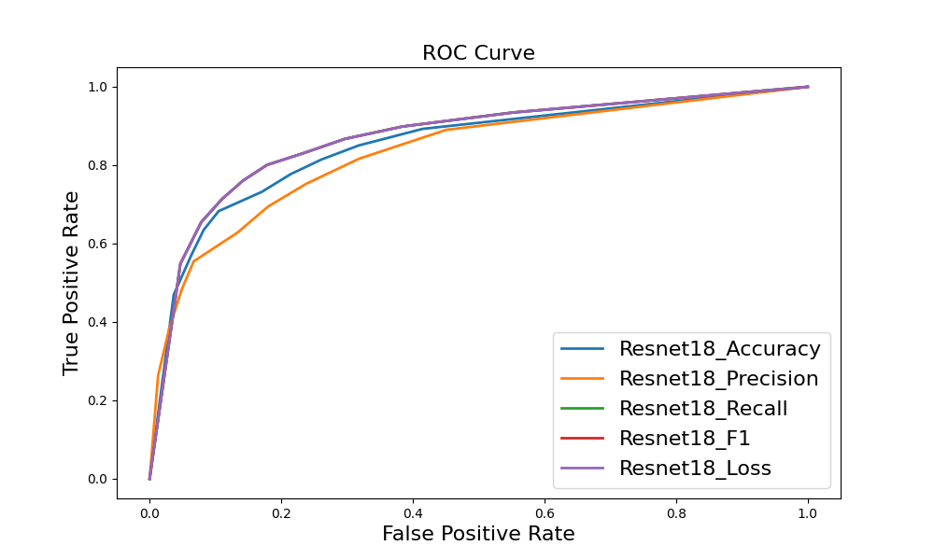

Slide 36
Gap ghmc | Accuracy | precision | recall | specificity | F1 | loss
Resnet18_accuracy | 78.4% | 77.6% | 65.1% | 87.3% | 70.8 | 1.0286
Resnet18_precision | 77.4% | 76.2% | 63.9% | 86.6% | 69.5 | 0.7702
Resnet18_recall | 75.5% | 67% | 77.3% | 74.4% | 71.8 | 0.9117
Resnet18_F1 | 75.4% | 66.4% | 78.8% | 73.1% | 72.1 | 0.9030
Resnet18_loss | 76.7% | 83% | 53.1% | 92.7% | 64.7 | 0.5324

Slide 37
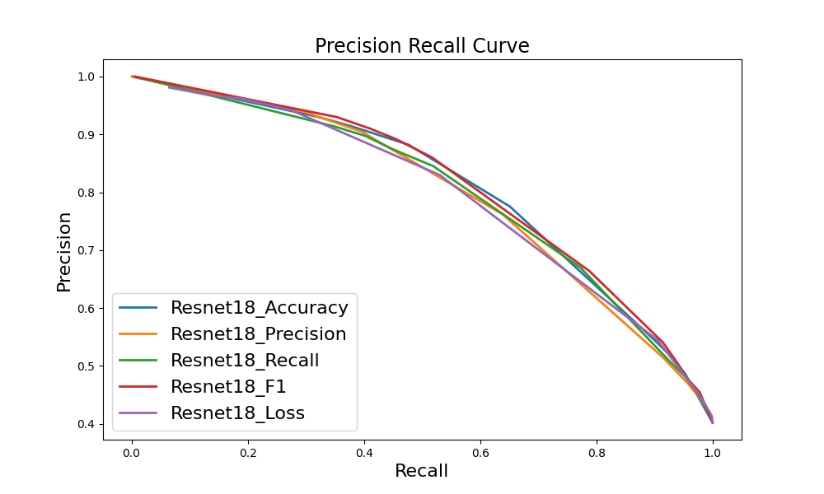

Slide 38
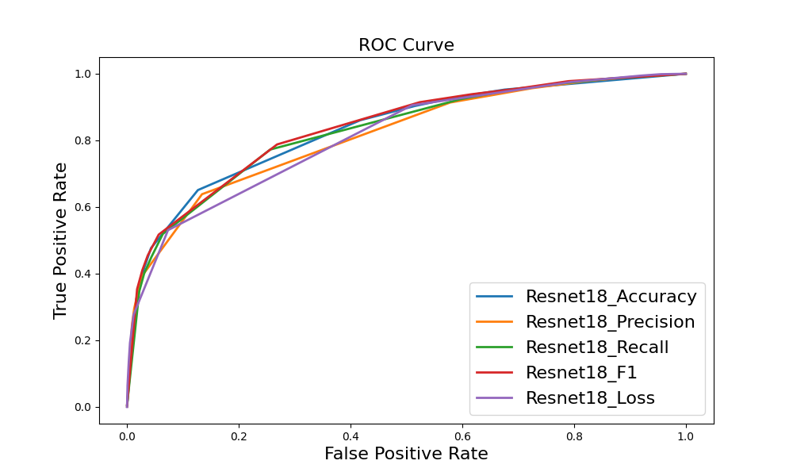

Slide 39
Union Square

Slide 40
Junction | Accuracy | precision | recall | specificity | F1 | loss
Resnet18_accuracy | 85.6% | 83.1% | 68.1% | 93.6% | 74.9 | 0.3546
Resnet18_precision | 85% | 86.9% | 61.7% | 95.7% | 72.2 | 0.3708
Resnet18_recall | 82% | 68.7% | 78.8% | 83.5% | 73.4 | 0.9276
Resnet18_F1 | 85.5% | 83% | 67.9% | 93.6% | 74.7 | 0.3916
Resnet18_loss | 85% | 86.9% | 61.7% | 95.7% | 72.2 | 0.3708

Slide 41
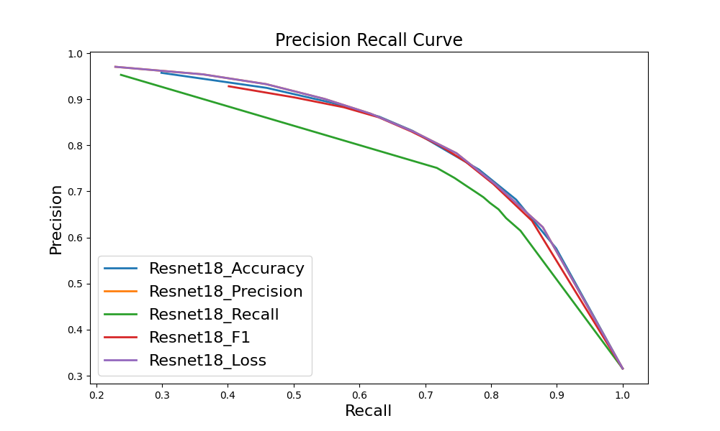

Slide 42
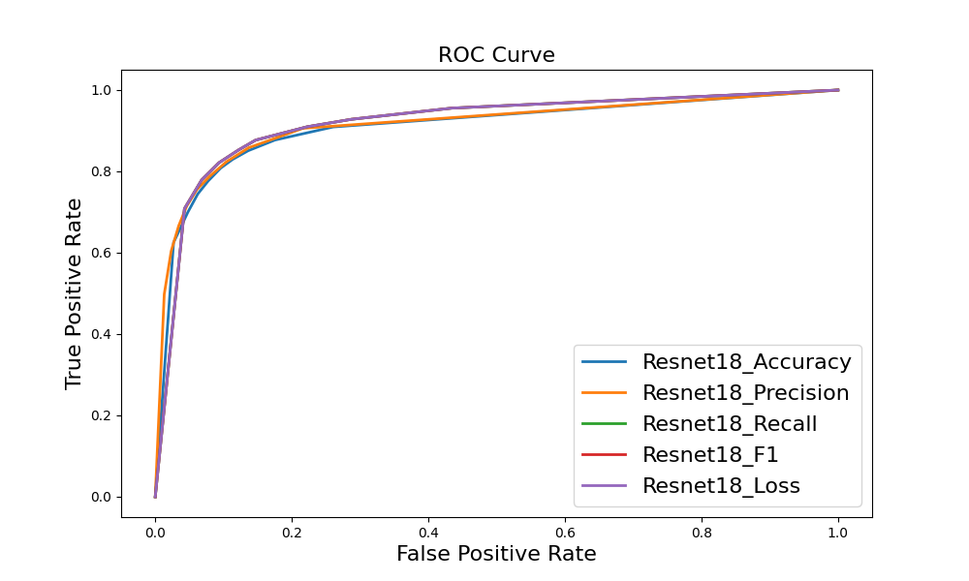

Slide 43
Junction ghmc | Accuracy | precision | recall | specificity | F1 | loss
Resnet18_accuracy | 83.9% | 81.5% | 63.1% | 93.4% | 71.2 | 0.7885
Resnet18_precision | 82.7% | 89.5% | 51.1% | 97.2% | 65 | 0.6606
Resnet18_recall | 79.7% | 63.8% | 82.6% | 78.4% | 72 | 0.5558
Resnet18_F1 | 84% | 75.4% | 72.9% | 89% | 74.2 | 1.3542
Resnet18_loss | 78.4% | 64.2% | 71.1% | 81.7% | 67.5 | 0.5655

Slide 44
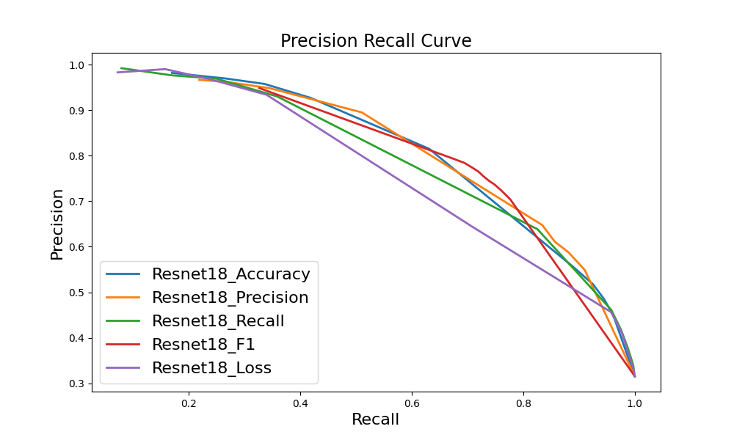

Slide 45
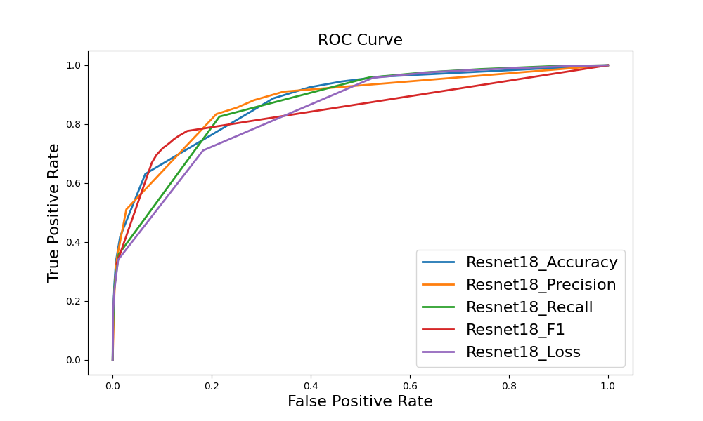

Slide 46
Gap | Accuracy | precision | recall | specificity | F1 | loss
Resnet18_accuracy | 86.3% | 86.4% | 80.8% | 90.4% | 83.5 | 0.3696
Resnet18_precision | 86% | 90.3% | 75.6% | 93.9% | 82.3 | 0.3572
Resnet18_recall | 86.3% | 81.8% | 87.7% | 85.3% | 84.6 | 0.3592
Resnet18_F1 | 86.3% | 81.8% | 87.7% | 85.3% | 84.6 | 0.3592
Resnet18_loss | 86.3% | 81.8% | 87.7% | 85.3% | 84.6 | 0.3592

Slide 47
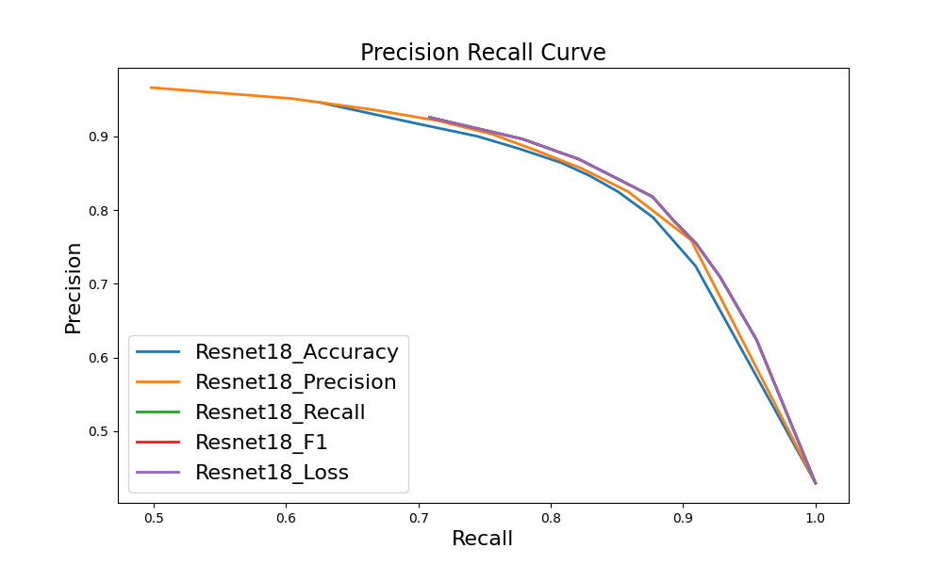

Slide 49
Gap ghmc | Accuracy | precision | recall | specificity | F1 | loss
Resnet18_accuracy | 85.4% | 86.8% | 77.8% | 91.1% | 82.1 | 1.0331
Resnet18_precision | 83.9% | 86.8% | 73.7% | 91.5% | 79.7 | 0.7982
Resnet18_recall | 83.6% | 77.8% | 86.5% | 81.4% | 81.9 | 0.8665
Resnet18_F1 | 82.7% | 76.2% | 86.6% | 79.7% | 81.1 | 0.9013
Resnet18_loss | 80.1% | 85.2% | 65% | 91.5% | 73.7 | 0.6012

Slide 50
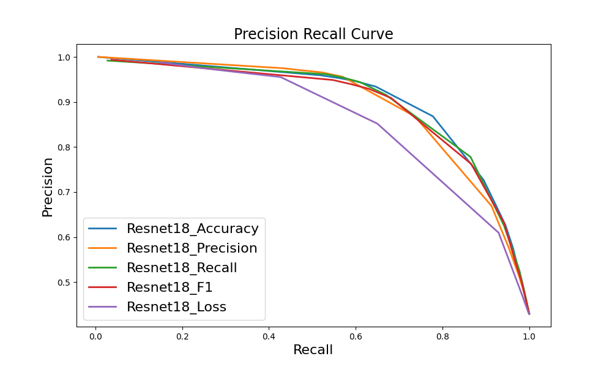

Slide 51
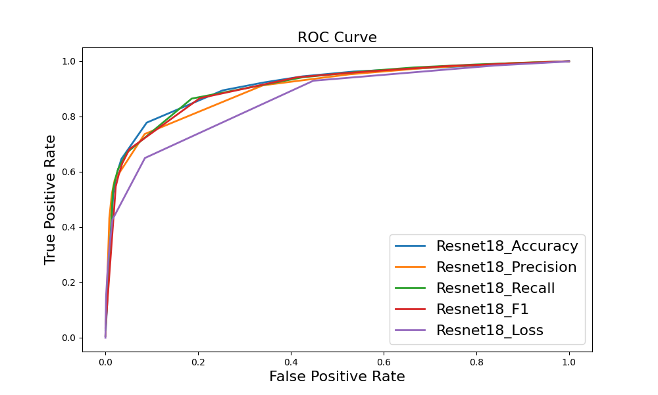

Slide 52
Classification Accuracy for Each Bit

Slide 53
Statistic accuracy for each bit
 |  | Bit 1 | Bit 2 | Bit 3 | Bit 4
Wall Street | Whole area | 71.72% | 81.08% | 71.56% | 81.56%
 | test routes | 75.27% | 83.45% | 76.19% | 85.15%
Union Square | Whole area | 81.5% | 86.58% | 82.52% | 86.08%
 | test routes | 81.39% | 87.55% | 82.28% | 86.61%
Hudson River | Whole area | 78.12% | 84.2% | 78.24% | 84.24%
 | test routes | 79.52% | 84.86% | 80.65% | 85.54%

Slide 54
Statistic accuracy for each category
 |  | junction | Non_junction | gap | Non_gap
Wall Street | Whole area | 65.09% | 76.5% | 80.06% | 82.17%
 | test routes | 72.19% | 77.99% | 85.07% | 83.59%
Union Square | Whole area | 78.83% | 83.47% | 87.69% | 85.31%
 | test routes | 77.12% | 83.88% | 89.11% | 85.57%
Hudson River | Whole area | 75.91% | 79.15% | 80.9% | 85.9%
 | test routes | 79.29% | 80.38% | 83.49% | 86.27%

Slide 55
Bit Flipping v2

Slide 56
Statistic accuracy for each bit
 |  | Bit 1 | Bit 2 | Bit 3 | Bit 4
Wall Street | Whole area | 72.06% | 80.56% | 70.54% | 81.82%
 | test routes | 72.42% | 81.65% | 71.4% | 81.34%
Union Square | Whole area | 81.5% | 86.2% | 82.2% | 86.58%
 | test routes | 80.84% | 86.19% | 82.04% | 86.67%

Slide 57
Statistic accuracy for each category
 |  | junction | Non_junction | gap | Non_gap
Wall Street | Whole area | 71.50% | 71.15% | 81.56% | 80.93%
 | test routes | 72.48% | 71.54% | 81.92% | 81.11%
Union Square | Whole area | 82.45% | 81.58% | 86.92% | 85.99%
 | test routes | 82.3% | 81.06% | 87.08% | 85.94%

Slide 58
Bit Flipping v3

Slide 59
Statistic accuracy for each bit
 |  | Bit 1 | Bit 2 | Bit 3 | Bit 4
Wall Street | Whole area | 71% | 81.64% | 71.68% | 81.46%
 | test routes | 70.32% | 81.81% | 72.96% | 80.75%
Union Square | Whole area | 81.96% | 85.82% | 82.54% | 85.62%
 | test routes | 82.24% | 85.62% | 82.4% | 85.69%

Slide 60
Statistic accuracy for each category
 |  | junction | Non_junction | gap | Non_gap
Wall Street | Whole area | 65.52% | 75.66% | 80.19% | 82.46%
 | test routes | 65.41% | 75.63% | 79.95% | 82.5%
Union Square | Whole area | 80.51% | 83.05% | 87.36% | 84.48%
 | test routes | 81.18% | 82.81% | 87.11% | 84.57%

Slide 61
Localisation Accuracy with different classifiers

Slide 62
Localisation Accuracy With Real Classifier (with Turns)
 | 5 | 10 | 15 | 20 | 25 | 30 | 35 | 40
Wall street | 0.038 | 0.352 | 0.662 | 0.82 | 0.898 | 0.942 | 0.96 | 0.952
v2 | 0.118 | 0.522 | 0.85 | 0.946 | 0.978 | 0.978 | 0.988 | 0.972
v3 | 0.072 | 0.488 | 0.834 | 0.948 | 0.974 | 0.98 | 0.992 | 0.968
Union square | 0.036 | 0.172 | 0.352 | 0.522 | 0.718 | 0.836 | 0.898 | 0.928
v2 | 0.136 | 0.496 | 0.794 | 0.916 | 0.982 | 0.992 | 0.994 | 0.986
v3 | 0.136 | 0.532 | 0.806 | 0.92 | 0.978 | 0.988 | 0.992 | 0.982

Slide 63
Localisation Accuracy With Real Classifier (without Turns)
 | 5 | 10 | 15 | 20 | 25 | 30 | 35 | 40
Wall street | 0.018 | 0.084 | 0.252 | 0.374 | 0.546 | 0.604 | 0.662 | 0.67
v2 | 0.052 | 0.218 | 0.458 | 0.652 | 0.85 | 0.86 | 0.876 | 0.886
v3 | 0.018 | 0.182 | 0.444 | 0.614 | 0.794 | 0.846 | 0.87 | 0.882
Union square | 0.02 | 0.078 | 0.146 | 0.262 | 0.35 | 0.472 | 0.558 | 0.644
v2 | 0.082 | 0.34 | 0.6 | 0.804 | 0.896 | 0.924 | 0.95 | 0.922
v3 | 0.08 | 0.368 | 0.656 | 0.79 | 0.898 | 0.92 | 0.936 | 0.91

Slide 64
BSD Distribution for Different Versions

Slide 65
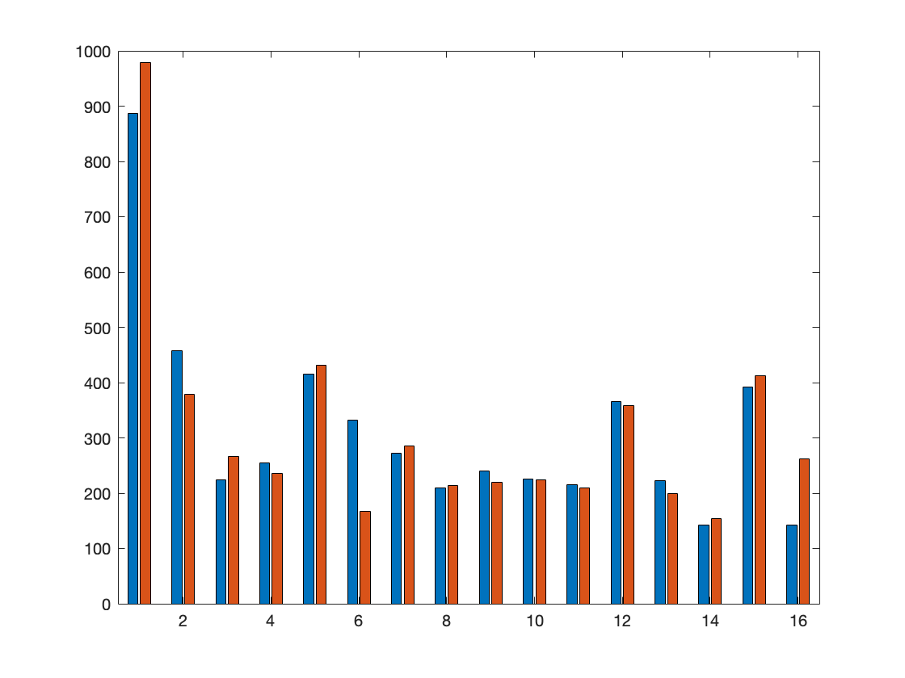
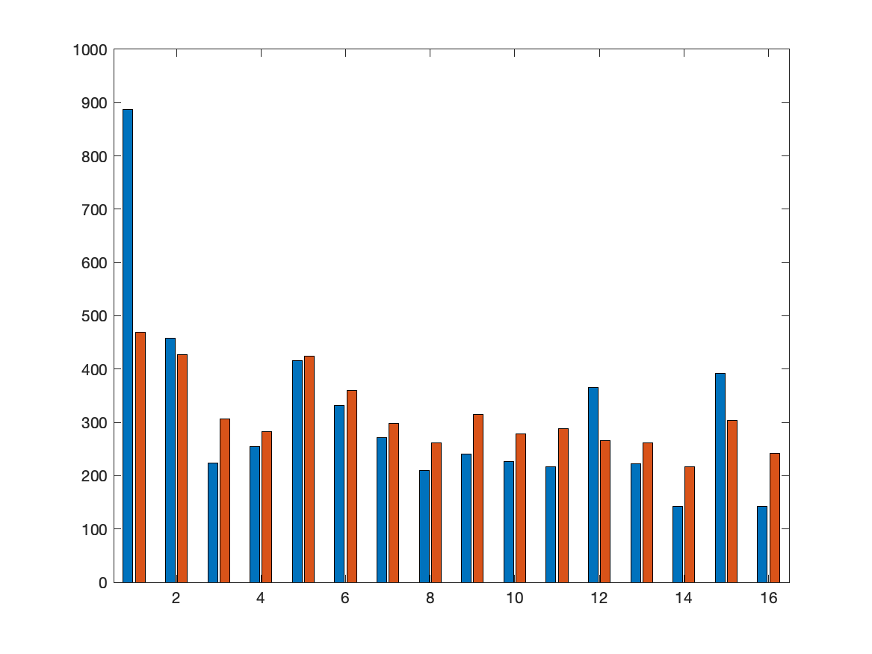
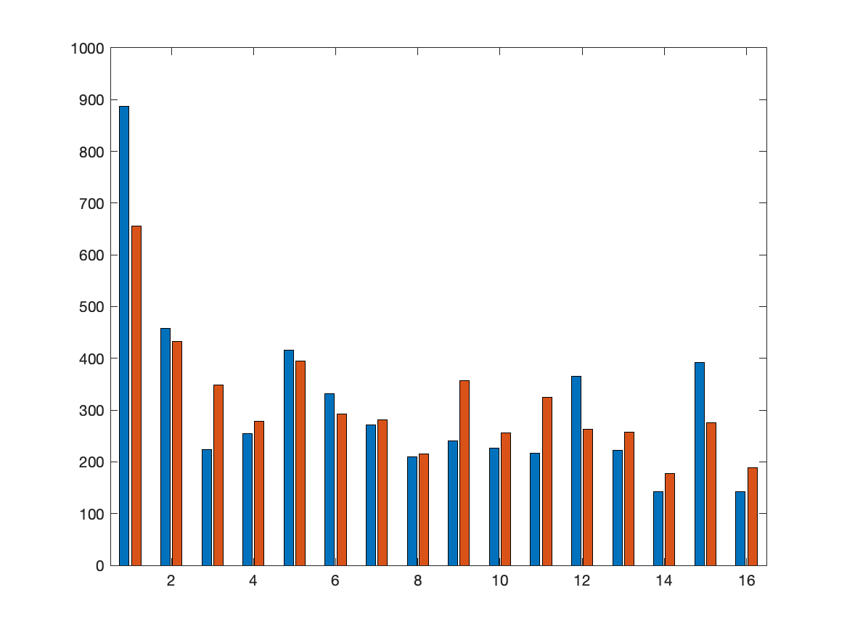
Wall Street
real
v2
v3

Slide 66
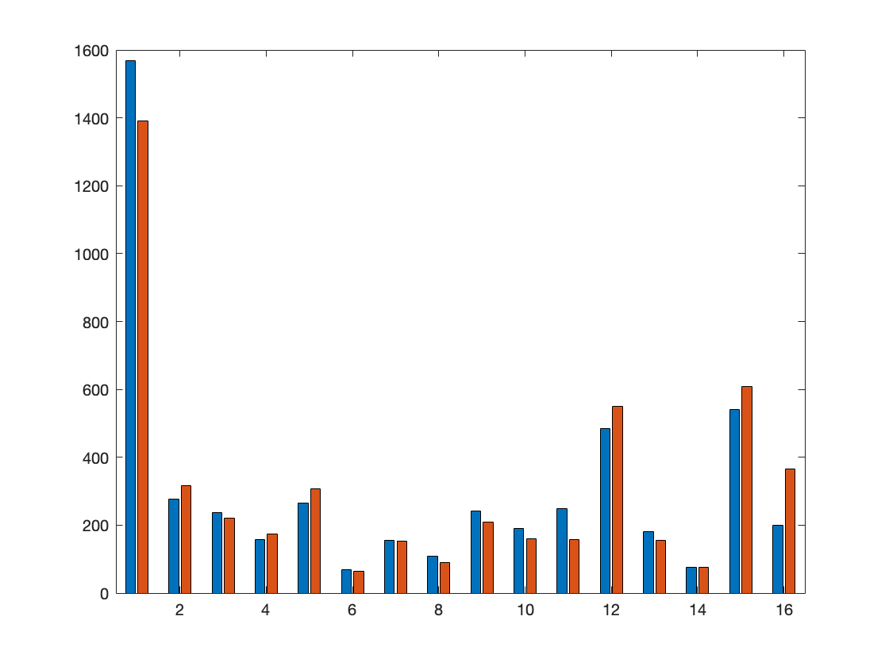
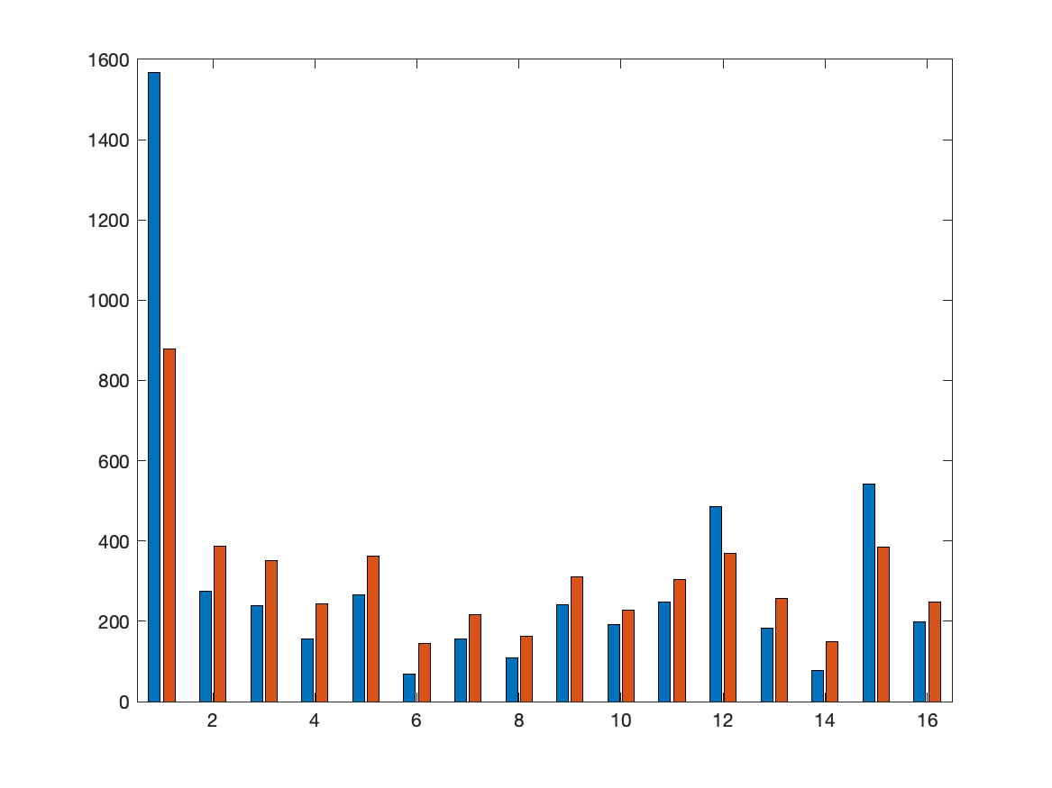

Union Square
real
v2
v3

Slide 67
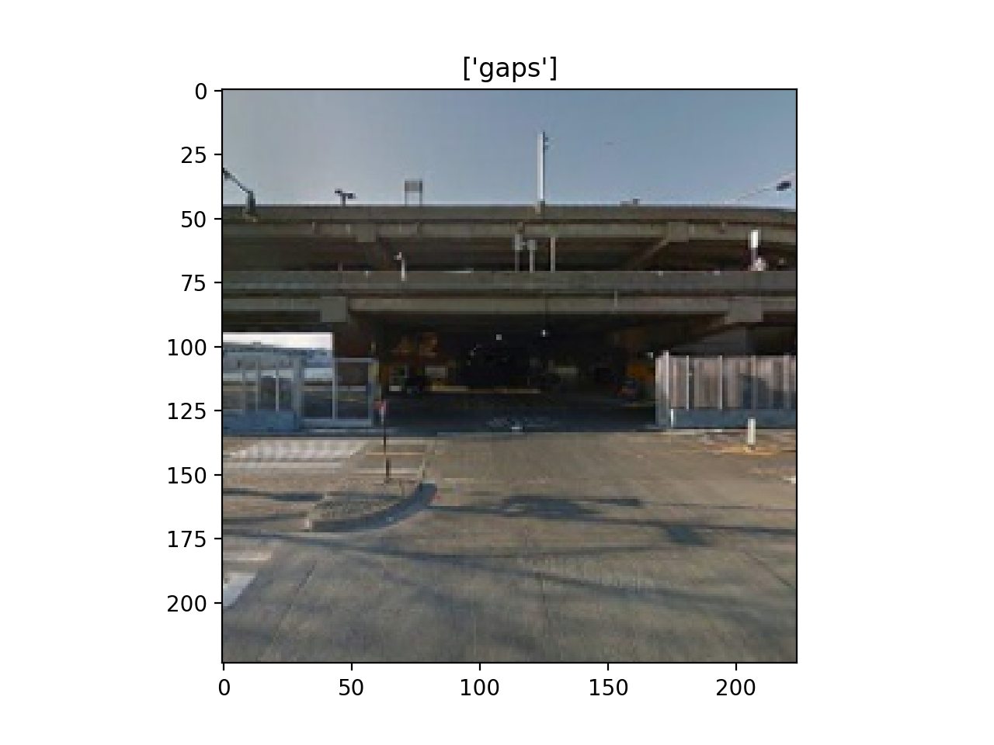
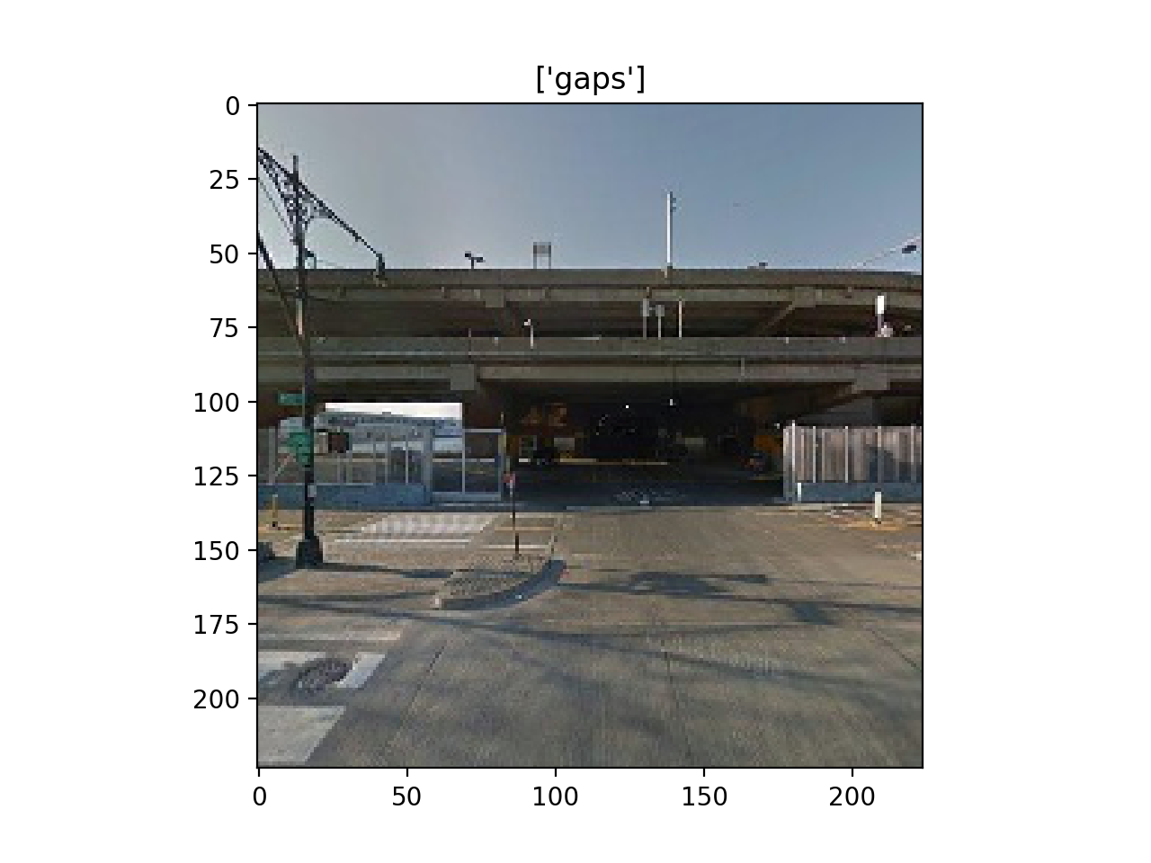
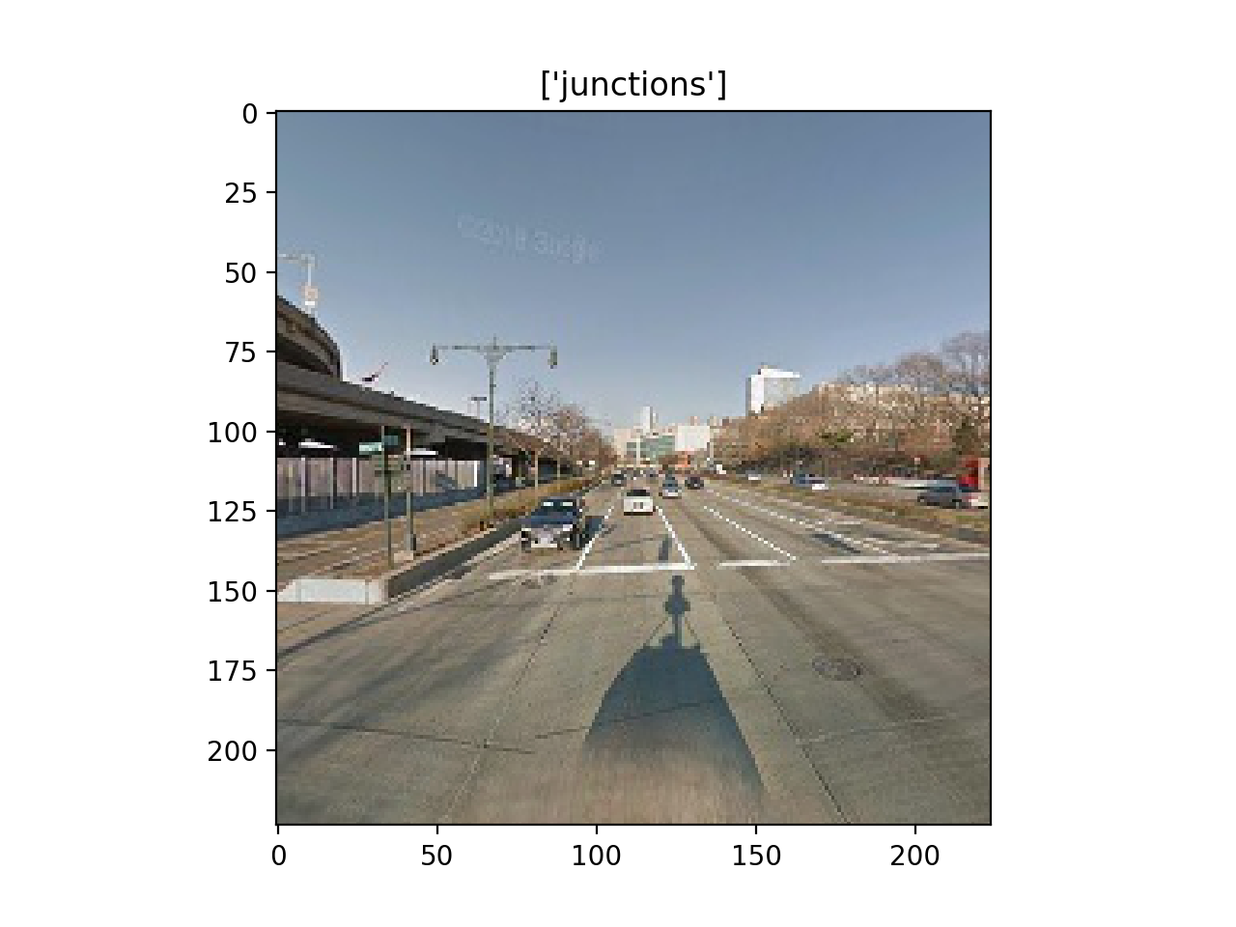
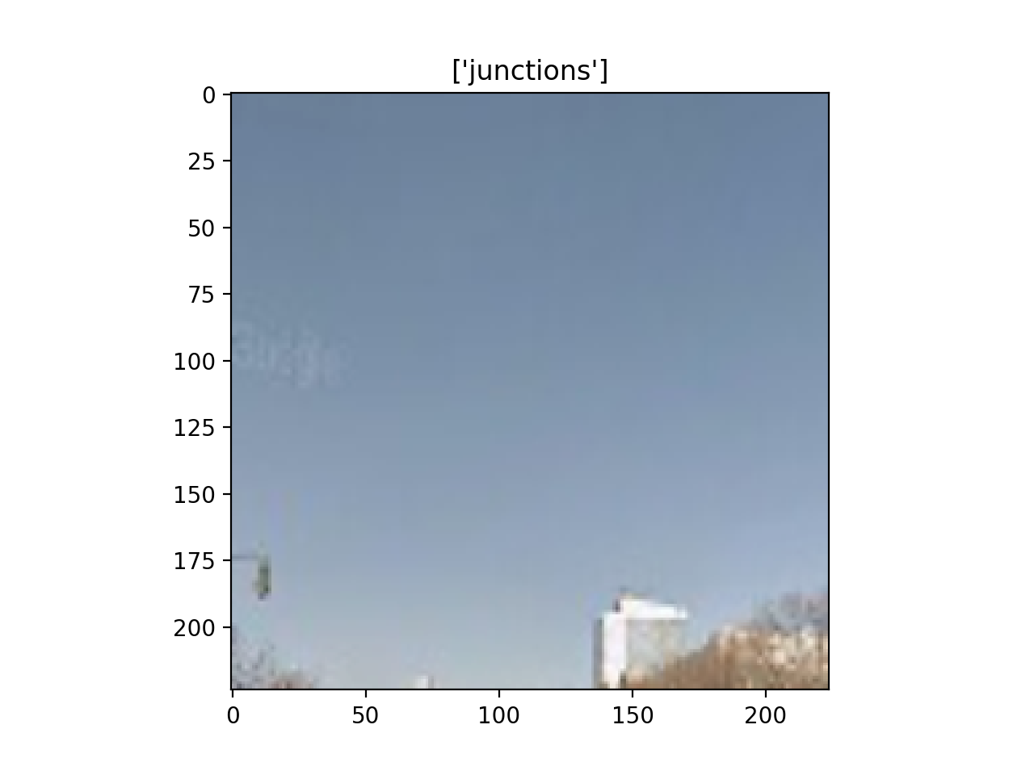
Some Errors

Slide 68
Route Distribution for Different Versions

Slide 69
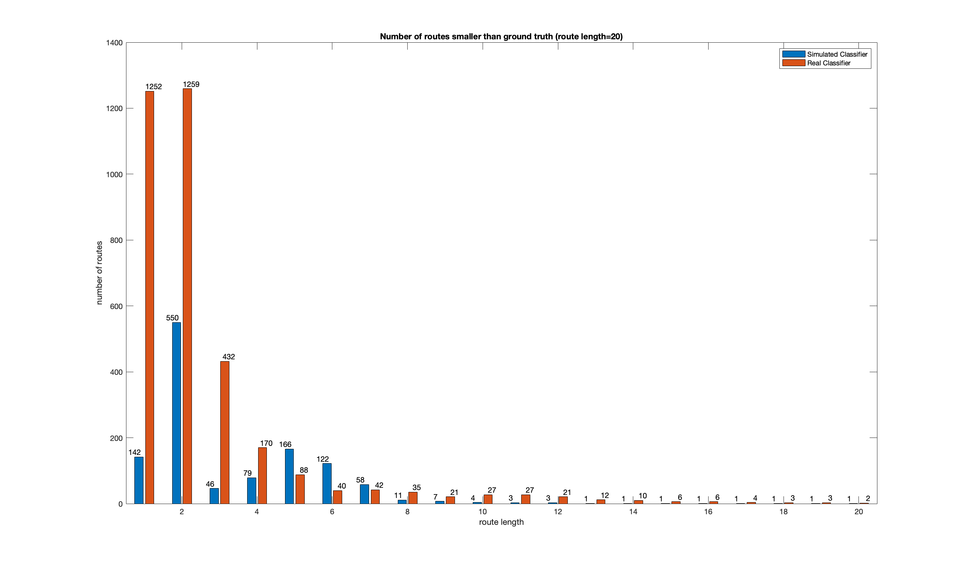
Route 1

Slide 70
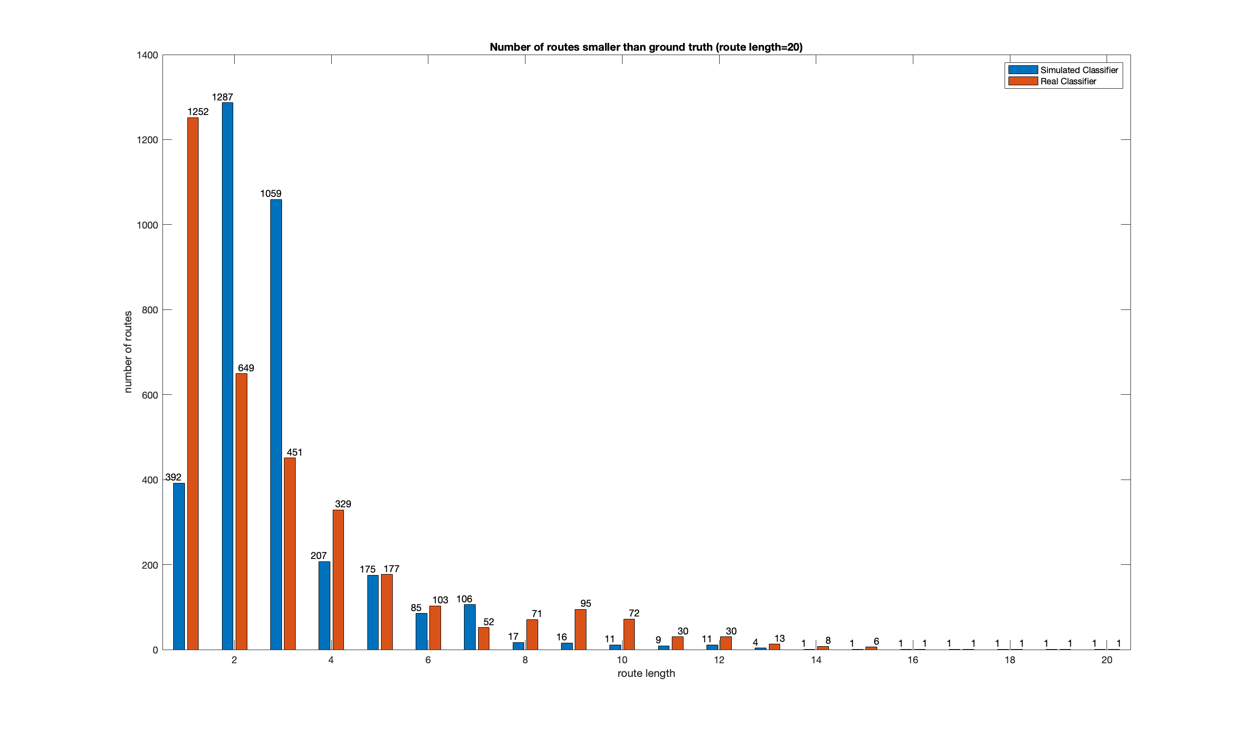
Route 60

Slide 71
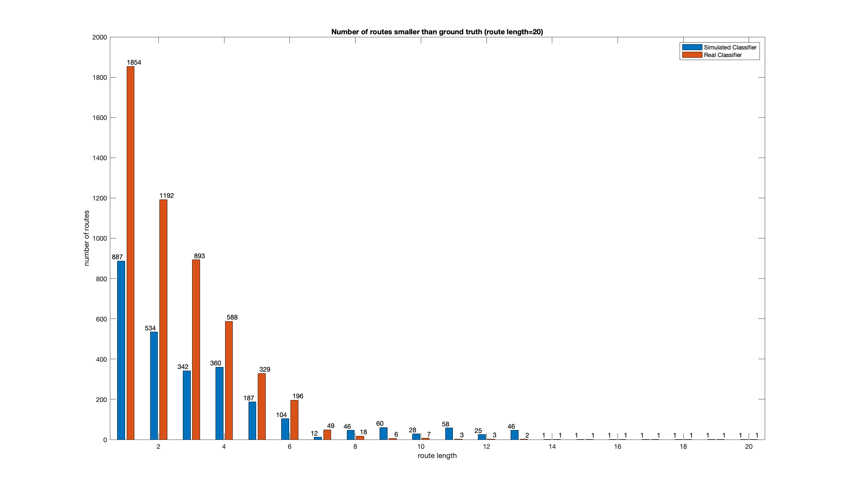
Route 120

Slide 72
Different Models

Slide 73
Hudson River

Slide 74
Junction | Accuracy | precision | recall | specificity | F1 | loss
Alexnet_accuracy | 0.804 | 0.699 | 0.607 | 0.888 | 0.650 | 0.4562
Alexnet_precision | 0.779 | 0.734 | 0.410 | 0.937 | 0.526 | 0.5238
Alexnet_recall | 0.722 | 0.524 | 0.756 | 0.707 | 0.619 | 0.5376
Alexnet_F1 | 0.795 | 0.662 | 0.646 | 0.859 | 0.654 | 0.4848
Alexnet_loss | 0.80 | 0.700 | 0.578 | 0.895 | 0.633 | 0.4555

Slide 75
Gap | Accuracy | precision | recall | specificity | F1 | loss
Alexnet_accuracy | 0.826 | 0.773 | 0.683 | 0.898 | 0.725 | 0.4196
Alexnet_precision | 0.808 | 0.797 | 0.577 | 0.925 | 0.670 | 0.4401
Alexnet_recall | 0.337 | 0.337 | 1.000 | 0.000 | 0.504 | 0.7061
Alexnet_F1 | 0.823 | 0.760 | 0.695 | 0.889 | 0.726 | 0.4435
Alexnet_loss | 0.826 | 0.773 | 0.683 | 0.898 | 0.725 | 0.4196

Slide 76
Gap_v2 | Accuracy | precision | recall | specificity | F1 | loss
Alexnet_accuracy | 0.826 | 0.757 | 0.713 | 0.884 | 0.734 | 0.4193
Alexnet_precision | 0.813 | 0.828 | 0.561 | 0.941 | 0.669 | 0.4338
Alexnet_recall | 0.762 | 0.616 | 0.784 | 0.751 | 0.689 | 0.4985
Alexnet_F1 | 0.826 | 0.757 | 0.713 | 0.884 | 0.734 | 0.4193
Alexnet_loss | 0.824 | 0.800 | 0.636 | 0.919 | 0.709 | 0.4125

Slide 77
Junction | Accuracy | precision | recall | specificity | F1 | loss
resnet50_accuracy | 0.832 | 0.764 | 0.633 | 0.917 | 0.692 | 0.4048
resnet50_precision | 0.826 | 0.808 | 0.548 | 0.944 | 0.653 | 0.4004
resnet50_recall | 0.746 | 0.552 | 0.799 | 0.723 | 0.653 | 1.1484
resnet50_F1 | 0.825 | 0.700 | 0.725 | 0.867 | 0.712 | 0.4099
resnet50_loss | 0.826 | 0.808 | 0.548 | 0.944 | 0.653 | 0.4004

Slide 78
Gap | Accuracy | precision | recall | specificity | F1 | loss
resnet50_accuracy | 0.852 | 0.835 | 0.700 | 0.930 | 0.761 | 0.3591
resnet50_precision | 0.843 | 0.853 | 0.647 | 0.943 | 0.736 | 0.3769
resnet50_recall | 0.819 | 0.697 | 0.822 | 0.818 | 0.754 | 0.5043
resnet50_F1 | 0.848 | 0.781 | 0.765 | 0.891 | 0.773 | 0.3773
resnet50_loss | 0.852 | 0.835 | 0.700 | 0.930 | 0.761 | 0.3591

Slide 79
Junction | Accuracy | precision | recall | specificity | F1 | loss
vgg_accuracy | 0.84 | 0.785 | 0.638 | 0.925 | 0.704 | 0.3840
vgg_precision | 0.833 | 0.817 | 0.567 | 0.946 | 0.670 | 0.3952
vgg_recall | 0.770 | 0.582 | 0.817 | 0.750 | 0.680 | 0.5029
vgg_F1 | 0.831 | 0.712 | 0.729 | 0.874 | 0.720 | 0.4053
vgg_loss | 0.840 | 0.785 | 0.638 | 0.925 | 0.704 | 0.3840

Slide 80
Gap | Accuracy | precision | recall | specificity | F1 | loss
vgg_accuracy | 0.853 | 0.786 | 0.774 | 0.893 | 0.780 | 0.4101
vgg_precision | 0.826 | 0.856 | 0.580 | 0.950 | 0.692 | 0.4142
vgg_recall | 0.833 | 0.724 | 0.815 | 0.842 | 0.766 | 0.4144
vgg_F1 | 0.853 | 0.786 | 0.774 | 0.893 | 0.780 | 0.4101
vgg_loss | 0.843 | 0.776 | 0.751 | 0.890 | 0.763 | 0.3945

Slide 81
Junction | Accuracy | precision | recall | specificity | F1 | loss
googlenet_accuracy | 0.837 | 0.755 | 0.673 | 0.907 | 0.712 | 0.3867
googlenet_precision | 0.837 | 0.755 | 0.673 | 0.907 | 0.712 | 0.3867
googlenet_recall | 0.759 | 0.572 | 0.771 | 0.754 | 0.657 | 1.4077
googlenet_F1 | 0.837 | 0.755 | 0.673 | 0.907 | 0.712 | 0.3867
googlenet_loss | 0.837 | 0.755 | 0.673 | 0.907 | 0.712 | 0.3867

Slide 82
Gap | Accuracy | precision | recall | specificity | F1 | loss
googlenet_accuracy | 0.853 | 0.790 | 0.767 | 0.896 | 0.779 | 0.3744
googlenet_precision | 0.847 | 0.839 | 0.677 | 0.934 | 0.749 | 0.3744
googlenet_recall | 0.819 | 0.697 | 0.816 | 0.820 | 0.752 | 0.9594
googlenet_F1 | 0.853 | 0.790 | 0.767 | 0.896 | 0.779 | 0.3744
googlenet_loss | 0.849 | 0.804 | 0.732 | 0.909 | 0.766 | 0.3541

Slide 83
Junction | Accuracy | precision | recall | specificity | F1 | loss
densenet_accuracy | 0.829 | 0.732 | 0.677 | 0.894 | 0.703 | 0.4071
densenet_precision | 0.825 | 0.772 | 0.587 | 0.926 | 0.667 | 0.4151
densenet_recall | 0.764 | 0.578 | 0.776 | 0.759 | 0.662 | 0.6468
densenet_F1 | 0.829 | 0.724 | 0.692 | 0.888 | 0.708 | 0.4041
densenet_loss | 0.825 | 0.719 | 0.683 | 0.886 | 0.700 | 0.4035

Slide 84
Gap | Accuracy | precision | recall | specificity | F1 | loss
densenet_accuracy | 0.851 | 0.778 | 0.779 | 0.887 | 0.779 | 0.3688
densenet_precision | 0.841 | 0.854 | 0.639 | 0.944 | 0.731 | 0.3771
densenet_recall | 0.822 | 0.707 | 0.804 | 0.831 | 0.753 | 1.3004
densenet_F1 | 0.851 | 0.777 | 0.781 | 0.886 | 0.779 | 0.3806
densenet_loss | 0.851 | 0.778 | 0.779 | 0.887 | 0.779 | 0.3688

Slide 85
Wall Street

Slide 86
Junction | Accuracy | precision | recall | specificity | F1 | loss
Alexnet_accuracy | 0.716 | 0.781 | 0.465 | 0.903 | 0.583 | 0.5634
Alexnet_precision | 0.670 | 0.809 | 0.294 | 0.948 | 0.432 | 0.6087
Alexnet_recall | 0.687 | 0.633 | 0.628 | 0.730 | 0.631 | 0.5961
Alexnet_F1 | 0.710 | 0.759 | 0.469 | 0.890 | 0.580 | 0.5622
Alexnet_loss | 0.698 | 0.779 | 0.405 | 0.915 | 0.533 | 0.5894

Slide 87
Gap | Accuracy | precision | recall | specificity | F1 | loss
Alexnet_accuracy | 0.753 | 0.729 | 0.617 | 0.845 | 0.668 | 0.5339
Alexnet_precision | 0.742 | 0.779 | 0.502 | 0.904 | 0.610 | 0.5527
Alexnet_recall | 0.402 | 0.402 | 1.000 | 0.000 | 0.574 | 0.7015
Alexnet_F1 | 0.755 | 0.5633 | 0.720 | 0.642 | 0.679 | 0.832
Alexnet_loss | 0.753 | 0.5339 | 0.729 | 0.617 | 0.668 | 0.845

Slide 88
Gap_v2 | Accuracy | precision | recall | specificity | F1 | loss
Alexnet_accuracy | 0.762 | 0.721 | 0.668 | 0.826 | 0.693 | 0.5104
Alexnet_precision | 0.748 | 0.793 | 0.507 | 0.911 | 0.618 | 0.5331
Alexnet_recall | 0.718 | 0.633 | 0.711 | 0.723 | 0.670 | 0.5514
Alexnet_F1 | 0.762 | 0.721 | 0.668 | 0.826 | 0.693 | 0.5104
Alexnet_loss | 0.770 | 0.788 | 0.586 | 0.894 | 0.672 | 0.5140

Slide 89
Junction | Accuracy | precision | recall | specificity | F1 | loss
resnet50_accuracy | 0.738 | 0.826 | 0.487 | 0.924 | 0.613 | 0.5908
resnet50_precision | 0.717 | 0.873 | 0.392 | 0.958 | 0.541 | 0.5967
resnet50_recall | 0.694 | 0.621 | 0.721 | 0.673 | 0.667 | 1.2624
resnet50_F1 | 0.741 | 0.773 | 0.554 | 0.879 | 0.646 | 0.5312
resnet50_loss | 0.717 | 0.873 | 0.392 | 0.958 | 0.541 | 0.5967

Slide 90
Gap | Accuracy | precision | recall | specificity | F1 | loss
resnet50_accuracy | 0.814 | 0.843 | 0.661 | 0.917 | 0.741 | 0.4384
resnet50_precision | 0.793 | 0.828 | 0.612 | 0.914 | 0.704 | 0.4541
resnet50_recall | 0.778 | 0.697 | 0.795 | 0.767 | 0.743 | 0.5829
resnet50_F1 | 0.798 | 0.748 | 0.752 | 0.829 | 0.750 | 0.4616
resnet50_loss | 0.814 | 0.843 | 0.661 | 0.917 | 0.741 | 0.4384

Slide 91
Junction | Accuracy | precision | recall | specificity | F1 | loss
googlenet_accuracy | 0.745 | 0.805 | 0.528 | 0.905 | 0.638 | 0.5208
googlenet_precision | 0.745 | 0.805 | 0.528 | 0.905 | 0.638 | 0.5208
googlenet_recall | 0.703 | 0.636 | 0.709 | 0.699 | 0.670 | 1.6266
googlenet_F1 | 0.745 | 0.805 | 0.528 | 0.905 | 0.638 | 0.5208
googlenet_loss | 0.745 | 0.805 | 0.528 | 0.905 | 0.638 | 0.5208

Slide 92
Gap | Accuracy | precision | recall | specificity | F1 | loss
googlenet_accuracy | 0.804 | 0.759 | 0.754 | 0.839 | 0.756 | 0.4504
googlenet_precision | 0.799 | 0.808 | 0.656 | 0.895 | 0.724 | 0.4493
googlenet_recall | 0.777 | 0.701 | 0.777 | 0.777 | 0.737 | 1.0550
googlenet_F1 | 0.804 | 0.759 | 0.754 | 0.839 | 0.756 | 0.4504
googlenet_loss | 0.803 | 0.785 | 0.702 | 0.871 | 0.741 | 0.4566

Slide 93
Junction | Accuracy | precision | recall | specificity | F1 | loss
vgg_accuracy | 0.746 | 0.833 | 0.504 | 0.925 | 0.628 | 0.5254
vgg_precision | 0.728 | 0.868 | 0.427 | 0.952 | 0.572 | 0.5608
vgg_recall | 0.731 | 0.681 | 0.693 | 0.759 | 0.687 | 0.5395
vgg_F1 | 0.748 | 0.767 | 0.586 | 0.868 | 0.664 | 0.5223
vgg_loss | 0.746 | 0.833 | 0.504 | 0.925 | 0.628 | 0.5254

Slide 94
Gap | Accuracy | precision | recall | specificity | F1 | loss
vgg_accuracy | 0.806 | 0.760 | 0.758 | 0.839 | 0.759 | 0.4755
vgg_precision | 0.768 | 0.820 | 0.543 | 0.920 | 0.654 | 0.5010
vgg_recall | 0.782 | 0.706 | 0.785 | 0.780 | 0.743 | 0.4916
vgg_F1 | 0.806 | 0.760 | 0.758 | 0.839 | 0.759 | 0.4755
vgg_loss | 0.788 | 0.753 | 0.705 | 0.844 | 0.729 | 0.4869

Slide 95
Junction | Accuracy | precision | recall | specificity | F1 | loss
densenet_accuracy | 0.740 | 0.783 | 0.541 | 0.889 | 0.640 | 0.5581
densenet_precision | 0.712 | 0.814 | 0.418 | 0.929 | 0.553 | 0.5953
densenet_recall | 0.712 | 0.663 | 0.658 | 0.752 | 0.661 | 0.7742
densenet_F1 | 0.736 | 0.778 | 0.532 | 0.887 | 0.632 | 0.5684
densenet_loss | 0.740 | 0.786 | 0.536 | 0.892 | 0.637 | 0.5416

Slide 96
Gap | Accuracy | precision | recall | specificity | F1 | loss
densenet_accuracy | 0.805 | 0.771 | 0.734 | 0.854 | 0.752 | 0.4544
densenet_precision | 0.796 | 0.849 | 0.598 | 0.929 | 0.702 | 0.4689
densenet_recall | 0.771 | 0.695 | 0.765 | 0.775 | 0.728 | 1.5267
densenet_F1 | 0.800 | 0.763 | 0.730 | 0.848 | 0.746 | 0.4674
densenet_loss | 0.805 | 0.771 | 0.734 | 0.854 | 0.752 | 0.4544

Slide 97
Union Square

Slide 98
Junction | Accuracy | precision | recall | specificity | F1 | loss
Alexnet_accuracy | 0.836 | 0.800 | 0.642 | 0.926 | 0.712 | 0.3978
Alexnet_precision | 0.786 | 0.795 | 0.433 | 0.949 | 0.561 | 0.5008
Alexnet_recall | 0.795 | 0.655 | 0.743 | 0.819 | 0.696 | 0.4601
Alexnet_F1 | 0.830 | 0.770 | 0.658 | 0.909 | 0.710 | 0.4212
Alexnet_loss | 0.824 | 0.802 | 0.588 | 0.933 | 0.679 | 0.4071

Slide 99
Gap | Accuracy | precision | recall | specificity | F1 | loss
Alexnet_accuracy | 0.842 | 0.870 | 0.744 | 0.916 | 0.802 | 0.3901
Alexnet_precision | 0.825 | 0.891 | 0.674 | 0.938 | 0.768 | 0.4023
Alexnet_recall | 0.430 | 0.430 | 1.000 | 0.000 | 0.601 | 0.6991
Alexnet_F1 | 0.842 | 0.848 | 0.771 | 0.896 | 0.808 | 0.3852
Alexnet_loss | 0.842 | 0.870 | 0.744 | 0.916 | 0.802 | 0.3901

Slide 100
Gap_v2 | Accuracy | precision | recall | specificity | F1 | loss
Alexnet_accuracy | 0.842 | 0.838 | 0.785 | 0.885 | 0.811 | 0.3823
Alexnet_precision | 0.831 | 0.906 | 0.676 | 0.947 | 0.774 | 0.3980
Alexnet_recall | 0.817 | 0.760 | 0.837 | 0.801 | 0.797 | 0.4195
Alexnet_F1 | 0.842 | 0.838 | 0.785 | 0.885 | 0.811 | 0.3823
Alexnet_loss | 0.829 | 0.864 | 0.716 | 0.915 | 0.783 | 0.4004

Slide 101
Junction | Accuracy | precision | recall | specificity | F1 | loss
resnet50_accuracy | 0.854 | 0.811 | 0.699 | 0.925 | 0.751 | 0.3687
resnet50_precision | 0.848 | 0.871 | 0.607 | 0.959 | 0.716 | 0.3666
resnet50_recall | 0.806 | 0.655 | 0.814 | 0.802 | 0.726 | 0.9444
resnet50_F1 | 0.852 | 0.791 | 0.723 | 0.912 | 0.756 | 0.3535
resnet50_loss | 0.848 | 0.871 | 0.607 | 0.959 | 0.716 | 0.3666

Slide 102
Gap | Accuracy | precision | recall | specificity | F1 | loss
resnet50_accuracy | 0.860 | 0.863 | 0.801 | 0.905 | 0.831 | 0.3473
resnet50_precision | 0.857 | 0.878 | 0.774 | 0.919 | 0.823 | 0.3545
resnet50_recall | 0.851 | 0.799 | 0.872 | 0.835 | 0.834 | 0.4189
resnet50_F1 | 0.866 | 0.846 | 0.840 | 0.885 | 0.843 | 0.3408
resnet50_loss | 0.860 | 0.863 | 0.801 | 0.831 | 0.905 | 0.3473

Slide 103
Junction | Accuracy | precision | recall | specificity | F1 | loss
googlenet_accuracy | 0.859 | 0.817 | 0.713 | 0.926 | 0.762 | 0.3374
googlenet_precision | 0.859 | 0.817 | 0.713 | 0.926 | 0.762 | 0.3374
googlenet_recall | 0.809 | 0.663 | 0.803 | 0.812 | 0.726 | 1.1526
googlenet_F1 | 0.859 | 0.817 | 0.713 | 0.926 | 0.762 | 0.3374
googlenet_loss | 0.859 | 0.817 | 0.713 | 0.926 | 0.762 | 0.3374

Slide 104
Gap | Accuracy | precision | recall | specificity | F1 | loss
googlenet_accuracy | 0.869 | 0.858 | 0.834 | 0.896 | 0.846 | 0.3363
googlenet_precision | 0.868 | 0.901 | 0.779 | 0.935 | 0.835 | 0.3289
googlenet_recall | 0.838 | 0.780 | 0.866 | 0.816 | 0.821 | 0.8072
googlenet_F1 | 0.869 | 0.858 | 0.834 | 0.896 | 0.846 | 0.3363
googlenet_loss | 0.867 | 0.875 | 0.806 | 0.913 | 0.839 | 0.3305

Slide 105
Junction | Accuracy | precision | recall | specificity | F1 | loss
vgg_accuracy | 0.856 | 0.825 | 0.689 | 0.932 | 0.751 | 0.3391
vgg_precision | 0.852 | 0.854 | 0.639 | 0.950 | 0.731 | 0.3583
vgg_recall | 0.806 | 0.645 | 0.859 | 0.782 | 0.737 | 0.4399
vgg_F1 | 0.860 | 0.794 | 0.753 | 0.910 | 0.772 | 0.3415
vgg_loss | 0.856 | 0.825 | 0.689 | 0.932 | 0.751 | 0.3391

Slide 106
Gap | Accuracy | precision | recall | specificity | F1 | loss
vgg_accuracy | 0.860 | 0.827 | 0.854 | 0.865 | 0.840 | 0.3755
vgg_precision | 0.840 | 0.916 | 0.690 | 0.953 | 0.787 | 0.3845
vgg_recall | 0.857 | 0.814 | 0.863 | 0.852 | 0.838 | 0.3560
vgg_F1 | 0.860 | 0.827 | 0.854 | 0.865 | 0.840 | 0.3755
vgg_loss | 0.867 | 0.866 | 0.817 | 0.905 | 0.840 | 0.3456

Slide 107
Junction | Accuracy | precision | recall | specificity | F1 | loss
densenet_accuracy | 0.857 | 0.795 | 0.736 | 0.913 | 0.765 | 0.3604
densenet_precision | 0.839 | 0.849 | 0.597 | 0.951 | 0.701 | 0.3848
densenet_recall | 0.820 | 0.682 | 0.804 | 0.827 | 0.738 | 0.5311
densenet_F1 | 0.856 | 0.814 | 0.706 | 0.925 | 0.756 | 0.3560
densenet_loss | 0.857 | 0.795 | 0.736 | 0.912 | 0.764 | 0.3431

Slide 108
Gap | Accuracy | precision | recall | specificity | F1 | loss
densenet_accuracy | 0.863 | 0.839 | 0.841 | 0.879 | 0.840 | 0.3399
densenet_precision | 0.851 | 0.887 | 0.749 | 0.928 | 0.812 | 0.3650
densenet_recall | 0.843 | 0.794 | 0.857 | 0.833 | 0.824 | 1.1142
densenet_F1 | 0.866 | 0.848 | 0.840 | 0.886 | 0.844 | 0.3387
densenet_loss | 0.863 | 0.839 | 0.841 | 0.879 | 0.840 | 0.3399

Slide 109
Visualization

Slide 110
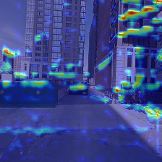
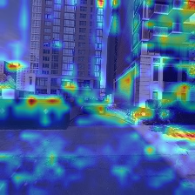
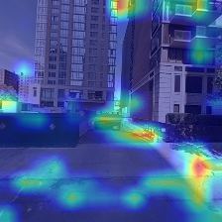
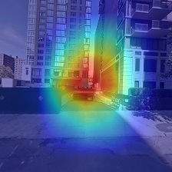
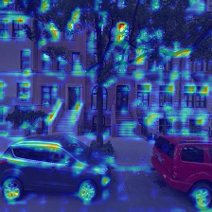
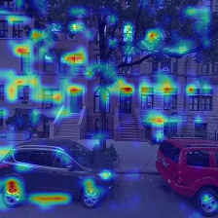
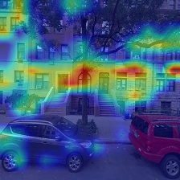
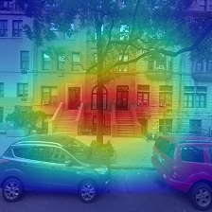
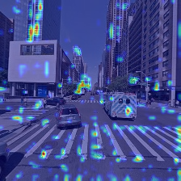







Layer 1
Layer 2
Layer 3
Layer 4
Building Gap
No Building Gap
Junction
No Junction

Slide 111
















Image 1
Image 2
Image 3
Image 4
Image 5
Building Gap
No Building Gap
Junction
No Junction

Slide 112
Resnet 18
 | Image 1 | Image 2 | Image 3 | Image 4 | Image 5
Building Gap | 0.99453 | 0.27181 | 0.99295 | 0.92428 | 0.94444
No Building Gap | 0.98170 | 0.99054 | 0.98009 | 0.98002 | 0.97606
Junction | 0.00090 | 0.99998 | 0.00044 | 0.99998 | 0.00296
No Junction | 0.99826 | 0.99519 | 1.00000 | 0.99946 | 0.91186

Slide 113
Vgg
 | Image 1 | Image 2 | Image 3 | Image 4 | Image 5
Building Gap | 0.80734 | 0.30326 | 0.98268 | 0.85101 | 0.96428
No Building Gap | 0.96848 | 0.97697 | 0.94701 | 0.92968 | 0.81141
Junction | 0.73604 | 0.97133 | 0.26553 | 0.94383 | 0.40466
No Junction | 0.76206 | 0.80352 | 0.95117 | 0.83735 | 0.30593

Slide 114
Resnet50
 | Image 1 | Image 2 | Image 3 | Image 4 | Image 5
Building Gap | 0.99843 | 0.45137 | 0.99659 | 0.89602 | 0.98828
No Building Gap | 0.99058 | 0.99900 | 0.95791 | 0.98979 | 0.98890
Junction | 0.24628 | 1.00000 | 0.26244 | 0.99709 | 0.00004
No Junction | 0.75196 | 0.99454 | 1.00000 | 0.99037 | 0.99999

Slide 115
Densenet161
 | Image 1 | Image 2 | Image 3 | Image 4 | Image 5
Building Gap | 0.99999 | 0.99845 | 1.00000 | 0.99995 | 1.00000
No Building Gap | 0.99999 | 0.98678 | 1.00000 | 0.99999 | 1.00000
Junction | 0.53776 | 0.83228 | 0.04932 | 0.22595 | 0.08937
No Junction | 0.97610 | 0.99303 | 0.99341 | 0.97780 | 0.69752

Slide 116
Alexnet
 | Image 1 | Image 2 | Image 3 | Image 4 | Image 5
Building Gap | 0.78955 | 0.47803 | 0.96968 | 0.79723 | 0.67145
No Building Gap | - | 0.76919 | 0.86056 | 0.86687 | 0.82159
Junction | - | 0.80725 | 0.55294 | 0.80725 | 0.59682
No Junction | 0.40683 | 0.51892 | 0.88813 | 0.61021 | 0.39895
Notes:
invalid value encountered in less
xa[xa < 0] = -1

Slide 117
Googlenet
 | Image 1 | Image 2 | Image 3 | Image 4 | Image 5
Building Gap | 1.00000 | 0.58887 | 0.99999 | 1.00000 | 0.69410
No Building Gap | 0.99984 | 1.00000 | 0.99523 | 0.99998 | 0.99999
Junction | 0.00825 | 1.00000 | 0.96614 | 0.99275 | 0.00075
No Junction | 0.99997 | 0.37688 | 1.00000 | 1.00000 | 0.91568

Slide 118



















Alexnet
VGG
Googlenet
Resnet18
Resnet50
Densenet 161
Building Gap
No Building Gap
Junction
No Junction

Slide 119






Slide 120
resnet18 recall junction 13
resnet18 accuracy junction 2
resnet18 precision junction 3
resnet18 loss junction 3
resnet18 F1 junction 5
resnet18 recall gap 4
resnet18 accuracy gap 5
resnet18 precision gap 3
resnet18 loss gap 4
resnet18 F1 gap 4
resnet50 recall junction 17
resnet50 accuracy junction 6
resnet50 precision junction 4
resnet50 loss junction 4
resnet50 F1 junction 3
resnet50 recall gap 9
resnet50 accuracy gap 4
resnet50 precision gap 3
resnet50 loss gap 4
resnet50 F1 gap 6

Slide 121
densenet161 recall junction 21
densenet161 accuracy junction 10
densenet161 precision junction 2
densenet161 loss junction 11
densenet161 F1 junction 12
densenet161 recall gap 52
densenet161 accuracy gap 8
densenet161 precision gap 4
densenet161 loss gap 8
densenet161 F1 gap 9
vgg recall junction 3
vgg accuracy junction 4
vgg precision junction 2
vgg loss junction 4
vgg F1 junction 5
vgg recall gap 4
vgg accuracy gap 6
vgg precision gap 1
vgg loss gap 5
vgg F1 gap 6

Slide 122
googlenet recall junction 39
googlenet accuracy junction 3
googlenet precision junction 3
googlenet loss junction 3
googlenet F1 junction 3
googlenet recall gap 19
googlenet accuracy gap 5
googlenet precision gap 3
googlenet loss gap 2
googlenet F1 gap 5
alexnet recall junction 83
alexnet accuracy junction 12
alexnet precision junction 2
alexnet loss junction 17
alexnet F1 junction 8
alexnet recall gap 54
alexnet accuracy gap 17
alexnet precision gap 27
alexnet loss gap 17
alexnet F1 gap 19

Slide 123
Improved Resnet18

Slide 124
Hudson River

Slide 125
Junction | Accuracy | precision | recall | specificity | F1 | loss
Resnet18_accuracy | 0.840 | 0.788 | 0.633 | 0.927 | 0.702 | 0.3777
Resnet18_precision | 0.840 | 0.788 | 0.633 | 0.927 | 0.702 | 0.3777
Resnet18_recall | 0.803 | 0.641 | 0.777 | 0.814 | 0.703 | 0.4334
Resnet18_F1 | 0.827 | 0.711 | 0.711 | 0.877 | 0.711 | 0.4006
Resnet18_loss | 0.840 | 0.788 | 0.633 | 0.927 | 0.702 | 0.3777
Notes:
Augmentation + smaller learning rate + weight decay

Slide 126
Junction | Accuracy | precision | recall | specificity | F1 | loss
Resnet18_accuracy | 0.836 | 0.761 | 0.656 | 0.912 | 0.705 | 0.3932
Resnet18_precision | 0.836 | 0.761 | 0.656 | 0.912 | 0.705 | 0.3932
Resnet18_recall | 0.803 | 0.644 | 0.764 | 0.820 | 0.699 | 0.4604
Resnet18_F1 | 0.830 | 0.719 | 0.710 | 0.881 | 0.714 | 0.3998
Resnet18_loss | 0.834 | 0.738 | 0.687 | 0.896 | 0.712 | 0.3926
Notes:
Smaller batch size = 64

Slide 127
Gap | Accuracy | precision | recall | specificity | F1 | loss
Resnet18_accuracy | 0.851 | 0.803 | 0.740 | 0.908 | 0.770 | 0.3637
Resnet18_precision | 0.849 | 0.822 | 0.705 | 0.922 | 0.759 | 0.3677
Resnet18_recall | 0.840 | 0.744 | 0.802 | 0.859 | 0.772 | 0.4658
Resnet18_F1 | 0.840 | 0.744 | 0.802 | 0.859 | 0.772 | 0.4658
Resnet18_loss | 0.851 | 0.803 | 0.740 | 0.908 | 0.770 | 0.3637

Slide 128
Gap | Accuracy | precision | recall | specificity | F1 | loss
Resnet18_accuracy | 0.858 | 0.821 | 0.741 | 0.918 | 0.779 | 0.3473
Resnet18_precision | 0.847 | 0.823 | 0.696 | 0.924 | 0.754 | 0.3694
Resnet18_recall | 0.836 | 0.728 | 0.820 | 0.844 | 0.771 | 0.4079
Resnet18_F1 | 0.856 | 0.802 | 0.760 | 0.905 | 0.781 | 0.3553
Resnet18_loss | 0.858 | 0.821 | 0.741 | 0.918 | 0.779 | 0.3473

Slide 129
Combined v1

Slide 130
Statistic accuracy for each bit
 |  | Bit 1 | Bit 2 | Bit 3 | Bit 4
Wall Street | Whole area | 70.82 | 57.92 | 55.84 | 74.06
 | test routes | 73.96 | 55.36 | 56.10 | 77.42
Union Square | Whole area | 82.44 | 52.42 | 60.64 | 81.76
 | test routes | 82.37 | 53.17 | 60.94 | 82.26
Hudson River | Whole area | 78.86 | 58.12 | 57.28 | 80.62
 | test routes | 81.95 | 52.83 | 59.38 | 81.47

Slide 131
Statistic accuracy for each category
 |  | junction | Non_junction | gap | Non_gap
Wall Street | Whole area | 47.11 | 75.37 | 62.27 | 68.5
 | test routes | 48.56 | 75.58 | 68.94 | 64.04
Union Square | Whole area | 58.4 | 77.6 | 79.94 | 57.41
 | test routes | 57.84 | 77.62 | 82.81 | 56.44
Hudson River | Whole area | 55.44 | 73.46 | 70.7 | 68.69
 | test routes | 57.27 | 75.72 | 75.07 | 62.16

Slide 132
Combined v2

Slide 133
Statistic accuracy for each bit
 |  | Bit 1 | Bit 2 | Bit 3 | Bit 4
Wall Street | Whole area | 73.14 | 75.8 | 72.02 | 78.08
 | test routes | 78.02 | 77.66 | 76.74 | 80.45
Union Square | Whole area | 85.54 | 84.88 | 86.06 | 85.04
 | test routes | 85.74 | 86.3 | 85.73 | 86.08
Hudson River | Whole area | 83.92 | 83.46 | 84.26 | 82.72
 | test routes | 85.13 | 82.66 | 85.85 | 82.73

Slide 134
Statistic accuracy for each category
 |  | junction | Non_junction | gap | Non_gap
Wall Street | Whole area | 43.80 | 93.94 | 56.45 | 90.73
 | test routes | 50.64 | 94.51 | 64.01 | 92.88
Union Square | Whole area | 64.51 | 95.62 | 72.52 | 94.34
 | test routes | 61.84 | 96.06 | 74.83 | 94.67
Hudson River | Whole area | 59.85 | 94.42 | 61.51 | 94.07
 | test routes | 61.85 | 94.41 | 64.54 | 94.15

